Slide 1



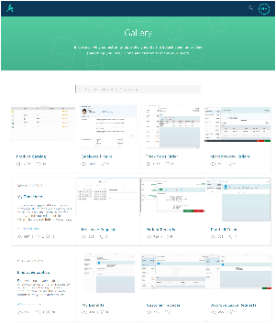
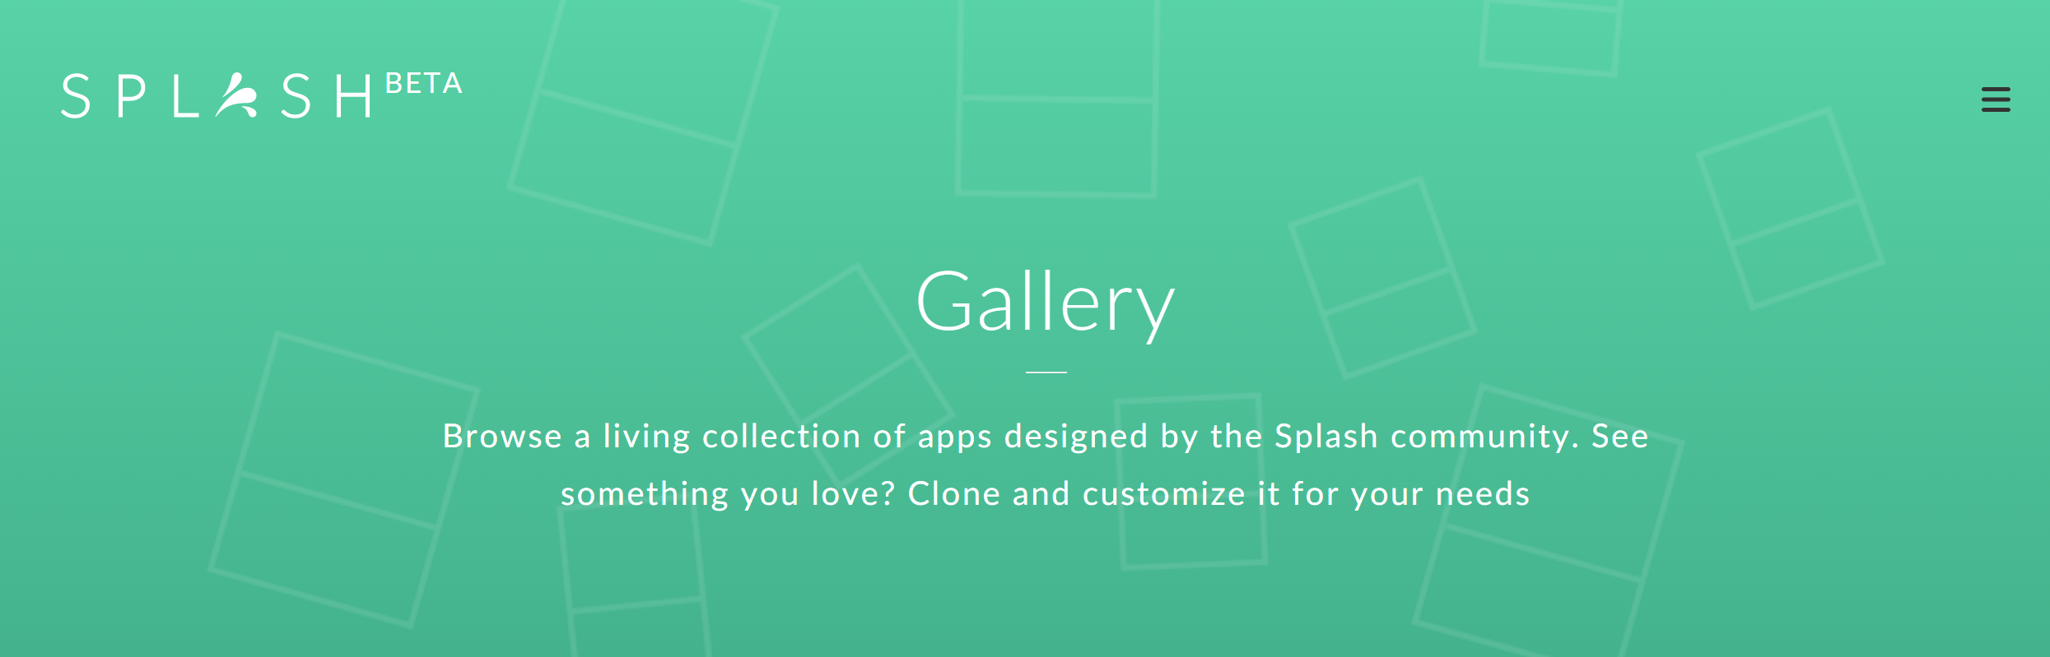
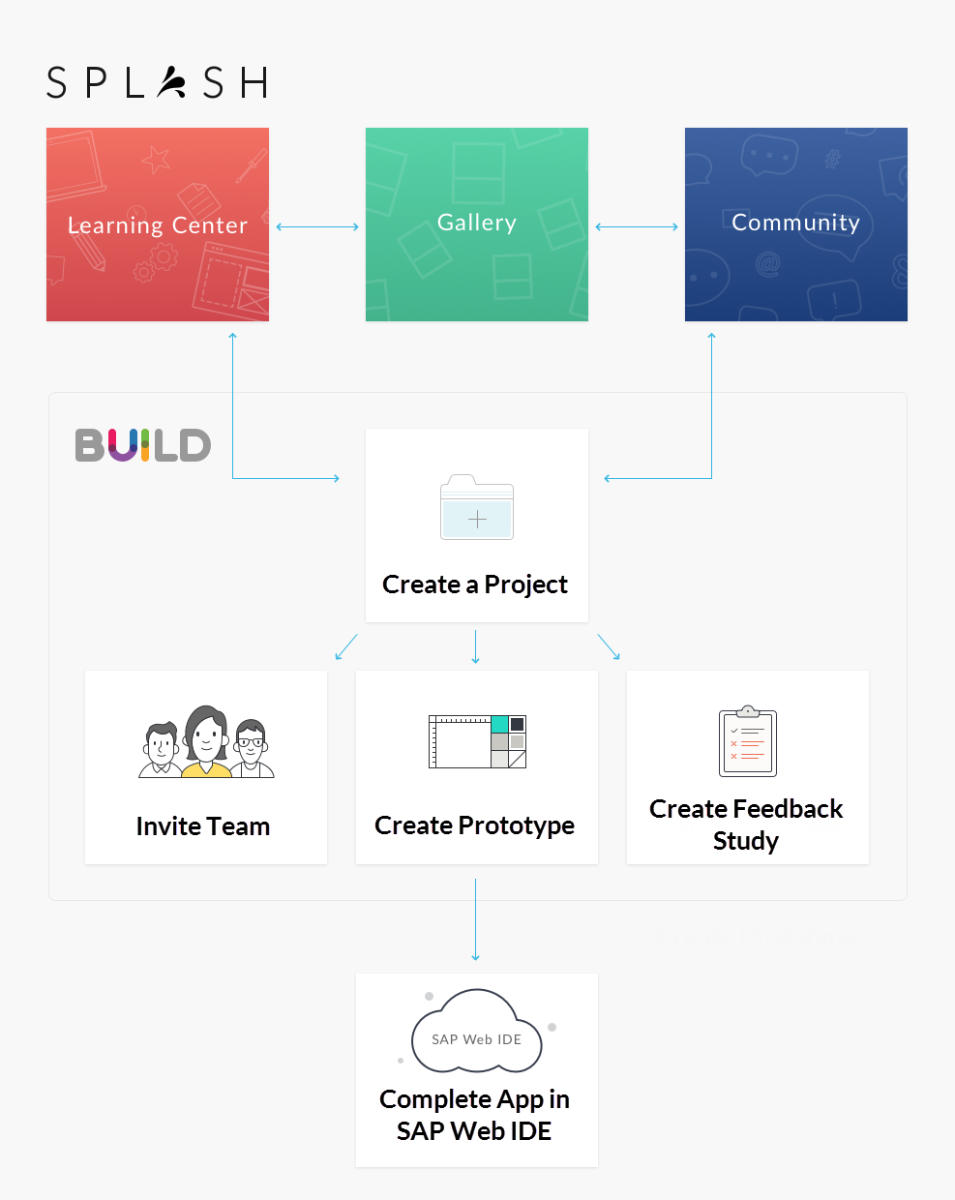
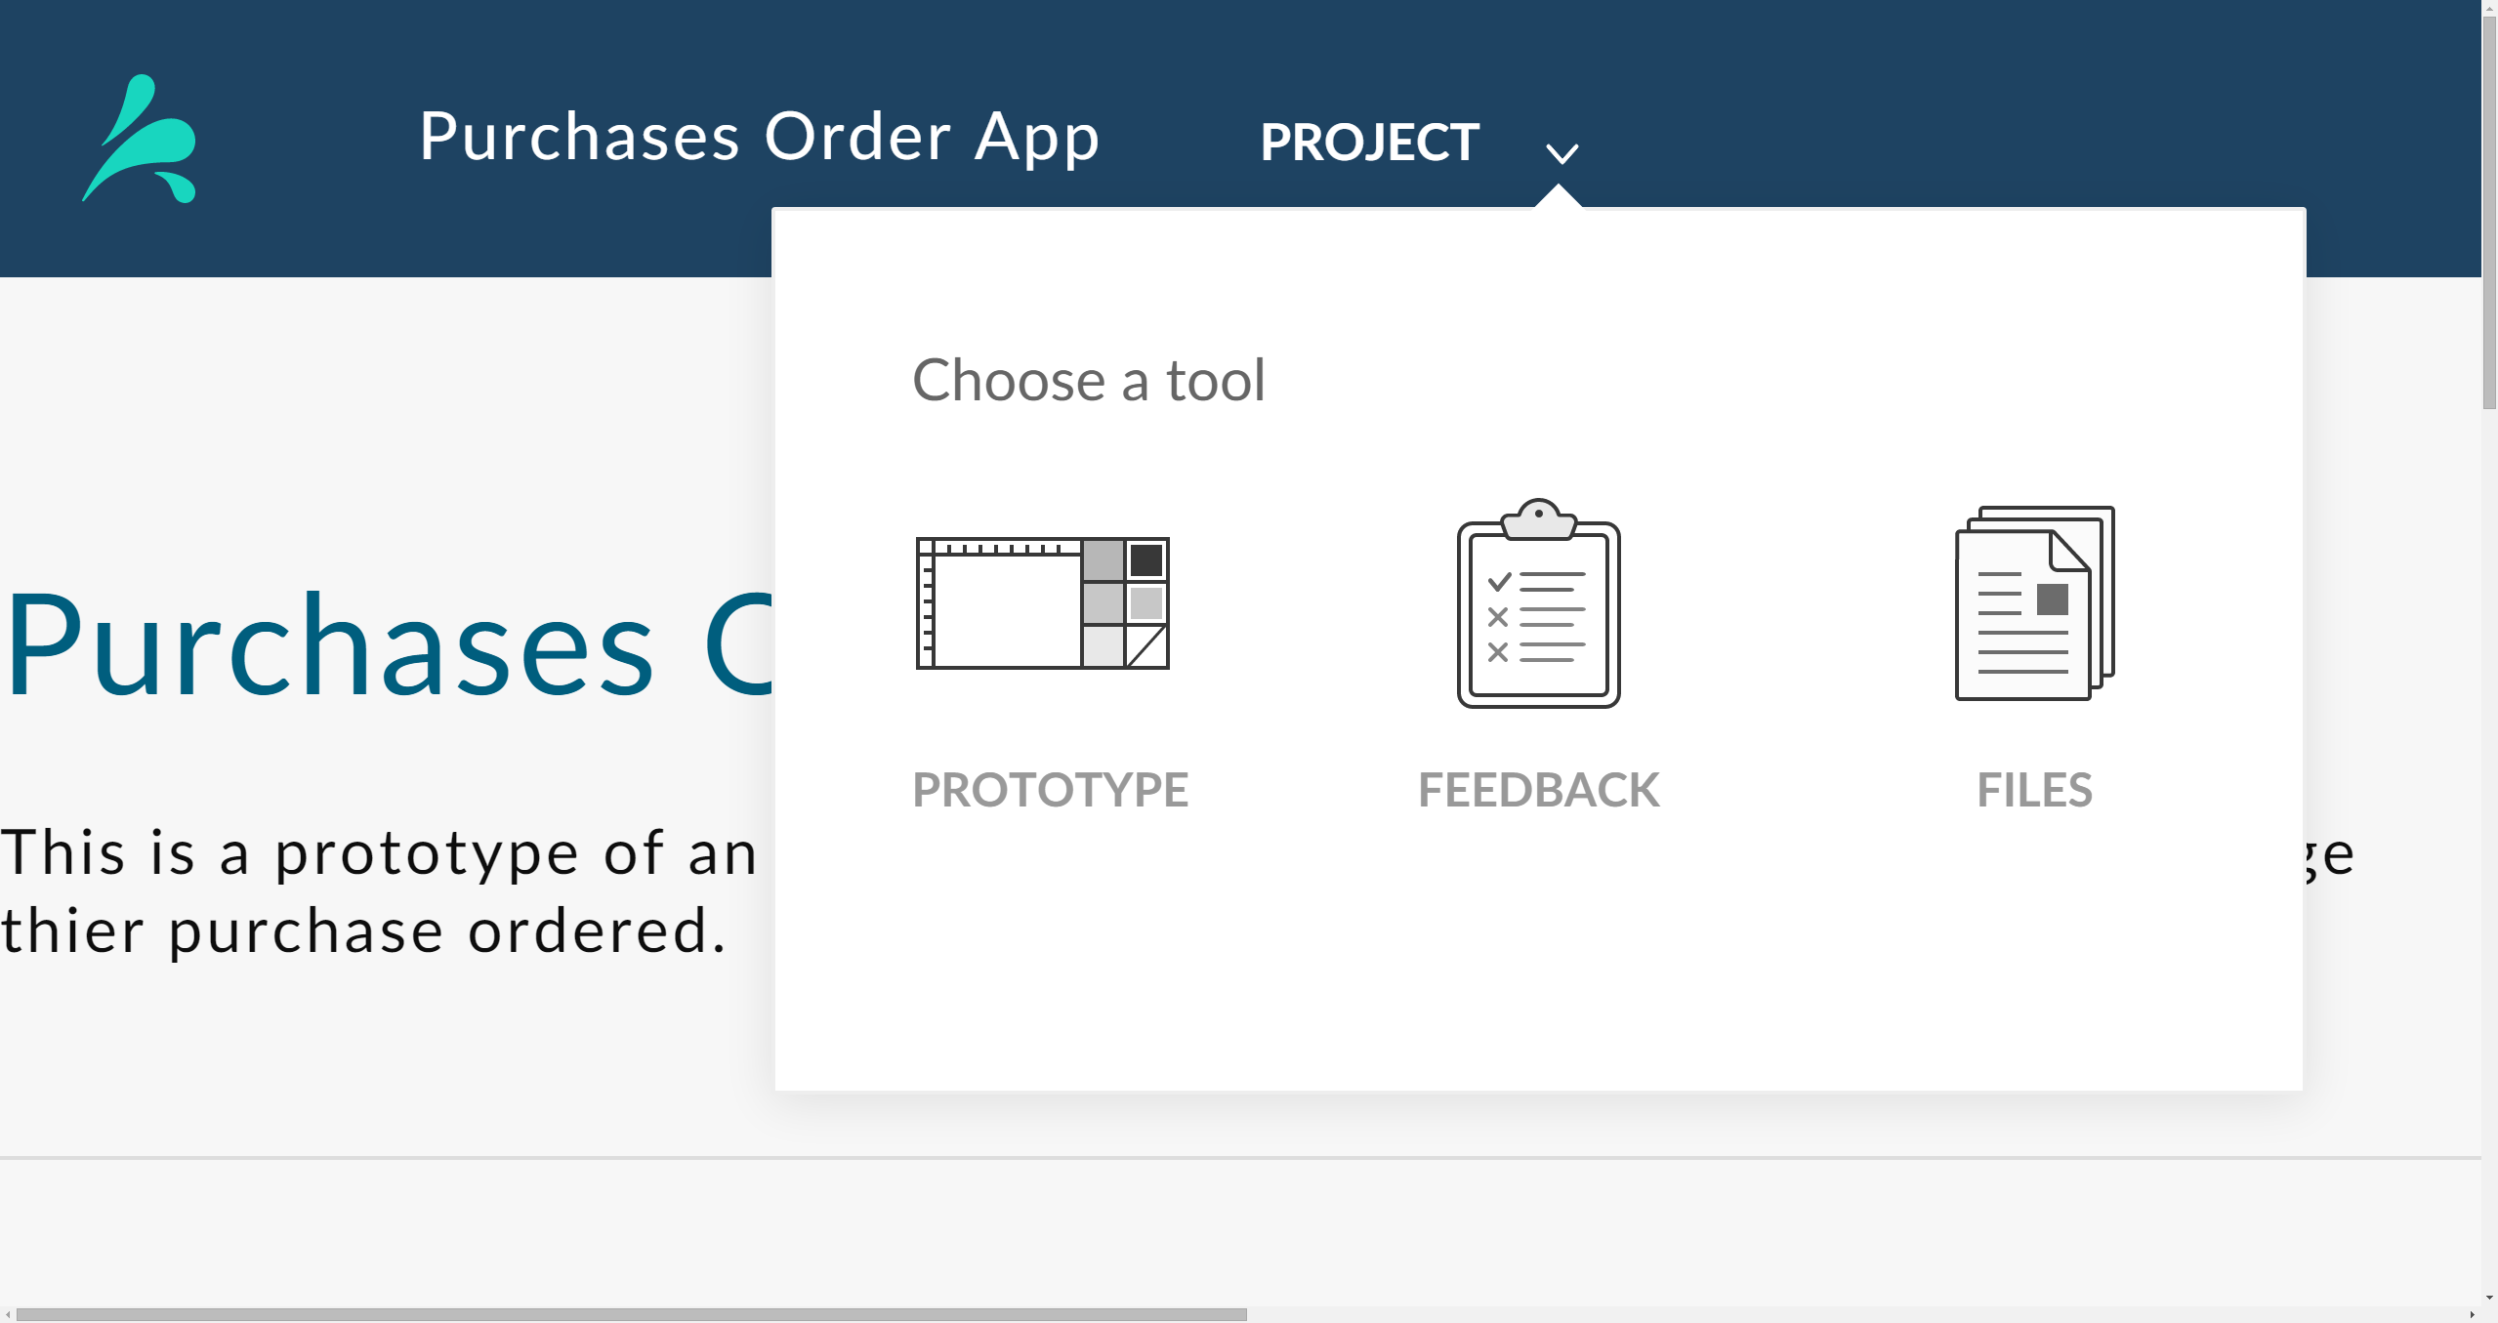
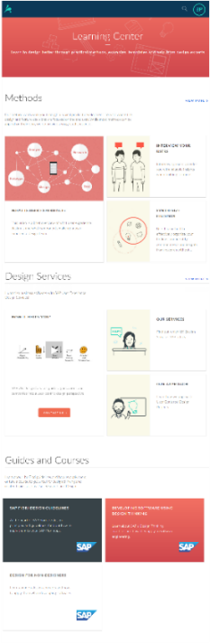

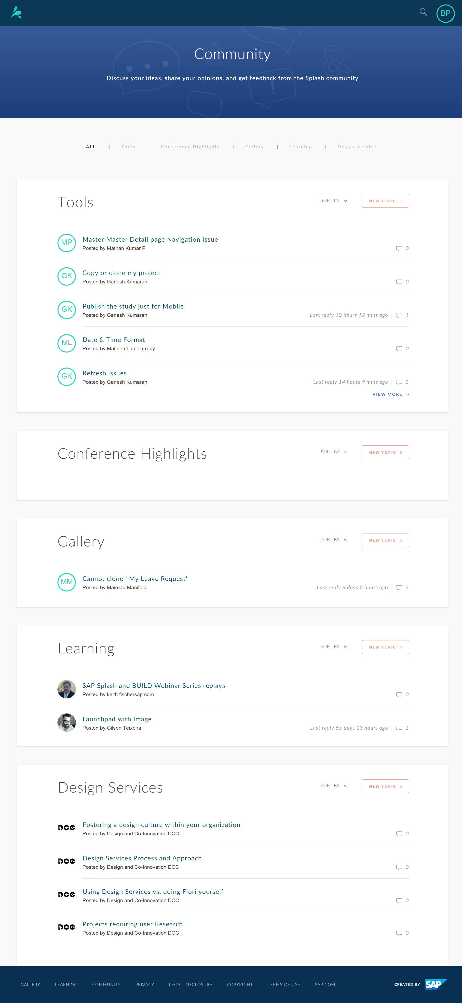
SPLASH
Overview
quick start guide 1/8
Find out what you need to create a publish your first Splash prototype.
SPLASH
Gallery
Tools
Overview
Overview
Overview
Splash features a Learning Centre, a Gallery, a Community section, and BUILD prototyping and feedback tools.
View, search, like and even clone sample projects and project that other Splash users have published and posted.
Clone a project and re-use the prototype as a basis for your own, or re-use only a singe page or single project asset, it's up to you.
Create a project to start using the state-of-the-art Splash Prototyping and Feedback tools to create your fully-functioning interactive prototype. Send Feedback studies to your end-users to get feedback about your prototype, or even just of your design images, and integrate their preferences into your prototype.
Learning
Overview
The Learning centre helps you quickly understand and learn the fundamentals of User Experience design. Learn about common user experience design practices through methods, design services, and courses.
Curious about learning useful tips to design awesome apps? Take advantage of the bite-size Method Cards, and try out the actionable tips.
Community
Overview
View, search, and participate in topics related to SPLASH and user experience design.
Each forum is divided into topics, where you can find and share information and resources on a specific subject.

Slide 2
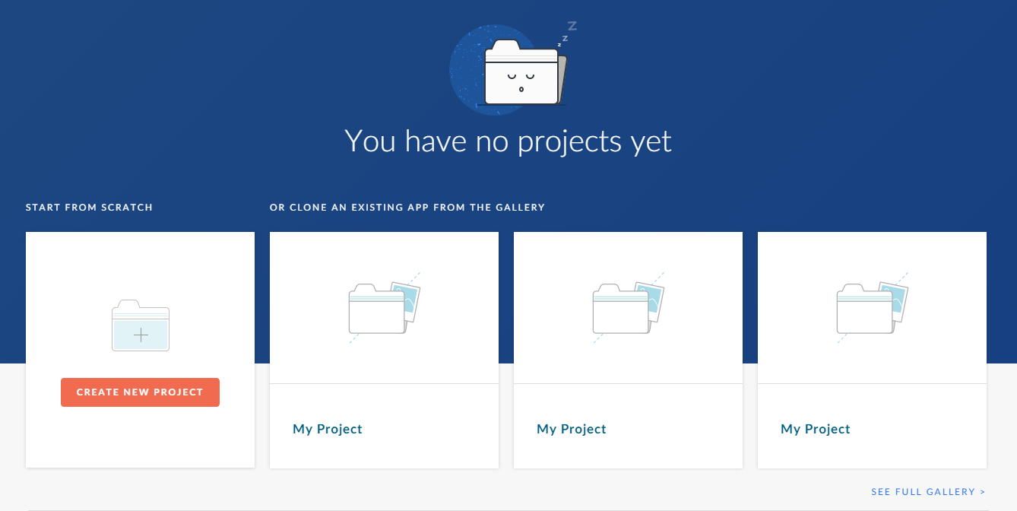
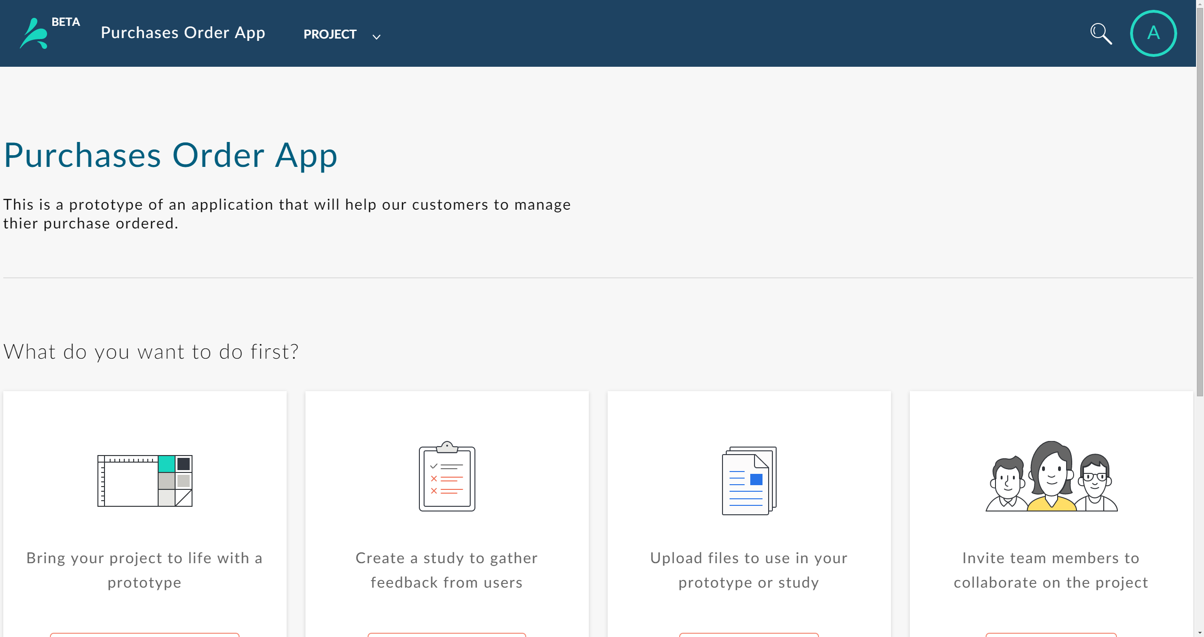
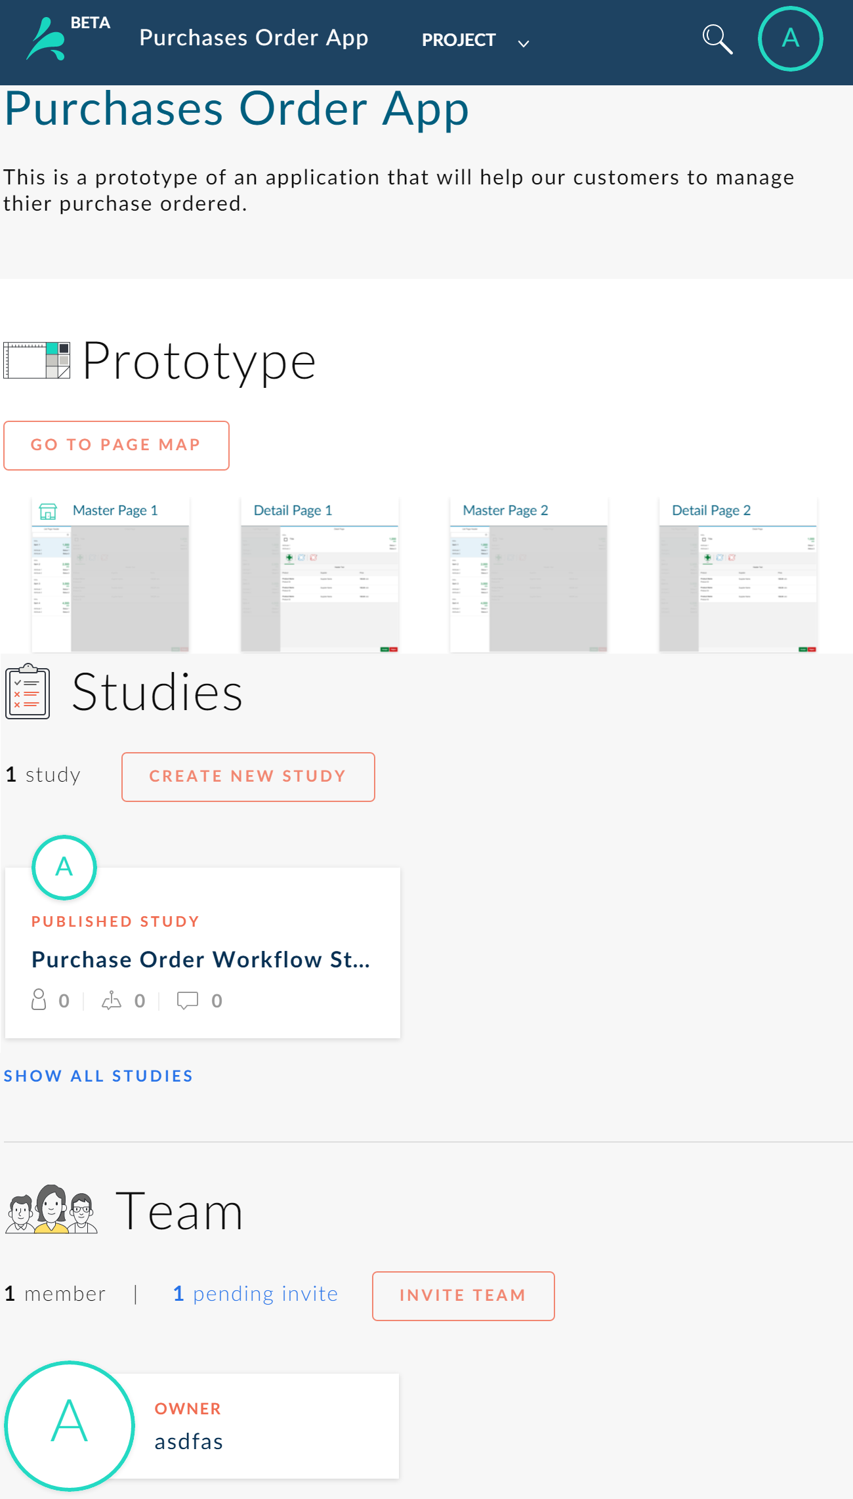
SPLASH
quick start guide 2/8
SPLASH Projects
SPLASH Projects
Learn what you can do in a Splash project
To create a project from scratch, log in to SPLASH and click CREATE NEW PROJECT on the Home page.
To clone a project, you click SEE FULL GALLERY on the Home page, select an existing project, and select CLONE.
In each SPLASH project, you can create a prototype application, create a team to collaborate with, and create feedback studies to do user research about your project.
You can create multiple projects in SPLASH.
The Project page displays:
Project name and description
A page-flow of the prototype (if you’ve started one)
An overview of the feedback studies you’ve created or are taking part in
An overview of the project team (if you’ve invited members)

Slide 3
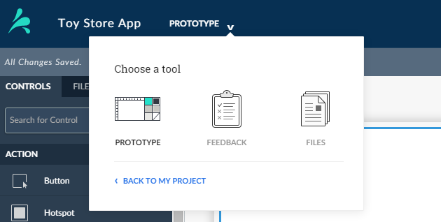
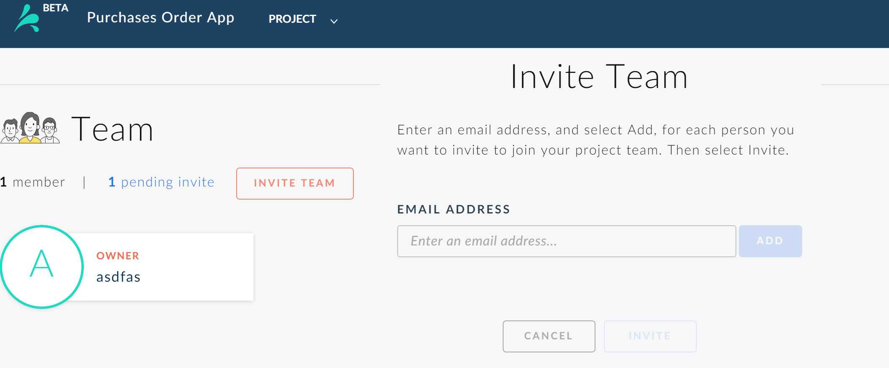
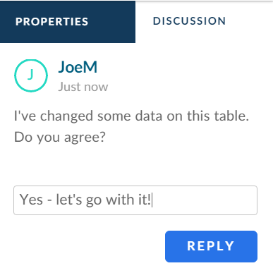
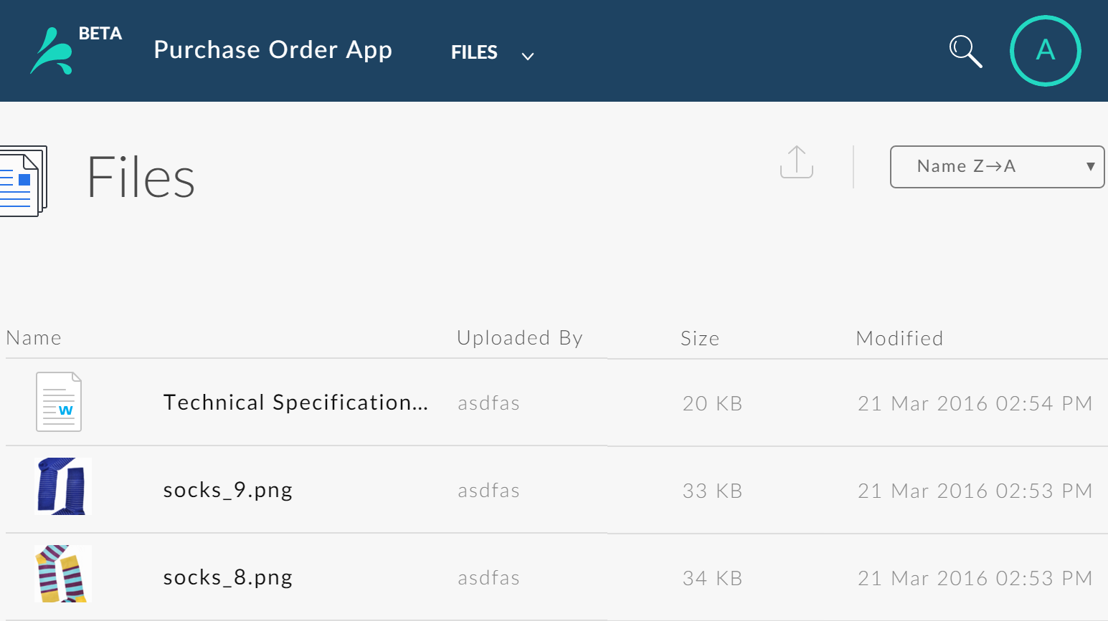
SPLASH
SPLASH Tools
quick start guide 3/8
Tool Picker
Pick a Tool to Work With
Invite Team Members
Learn about creating a team and collaborating on your projet
Switch between Splash tools by opening a project and using the Tool Picker on the Toolbar to select any of the following:
Files tool– Add files to be used in the prototype or feedback studies.
To create a project team select Invite Team on the Project page. On the Invite Team dialog, enter the email address of a collaborator you want to invite and select Add. Enter an email and select Add for each member, and select Invite.
Feedback tool – Create feedback studies by adding images and asking questions, and adding prototypes and setting actions to be performed, and sent the study to participants to get their feedback.
Files tool– Create realistic and interactive prototype pages in the Prototype tool with the User Interface (UI) Editor.
Splash sends an email containing a link to the study.
To accept and become team members of your project, your invitees need to have a Splash account or to create one.
Collaborate with Team Members
Team members invited to a project can do everything in a project except delete or archive the project, including:
View and edit the project prototype application
Create feedback studies and view responses to all user research studies
View, add, and delete files on the Files tool page
Invite additional colleagues to become team members of the project
View and post discussion on the Discussion tab in the UI Composer
Files Tool
Pick a Tool to Work With
You can upload images, documents, media files, and HTML prototypes to your project on the Files tool page, and then use them in your project when creating a prototype, creating feedback studies, or adding a project picture.

Slide 4
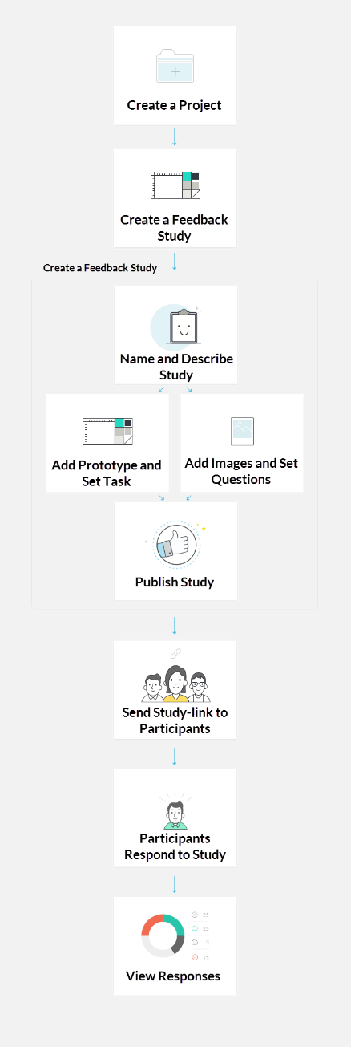
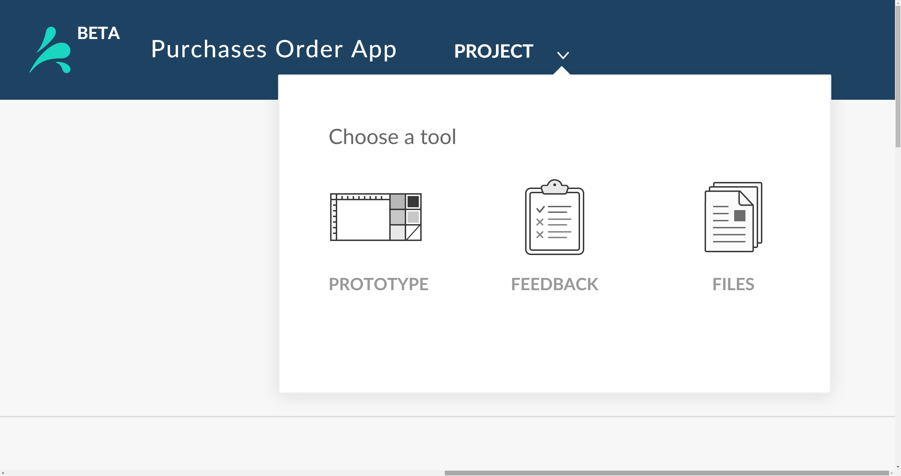
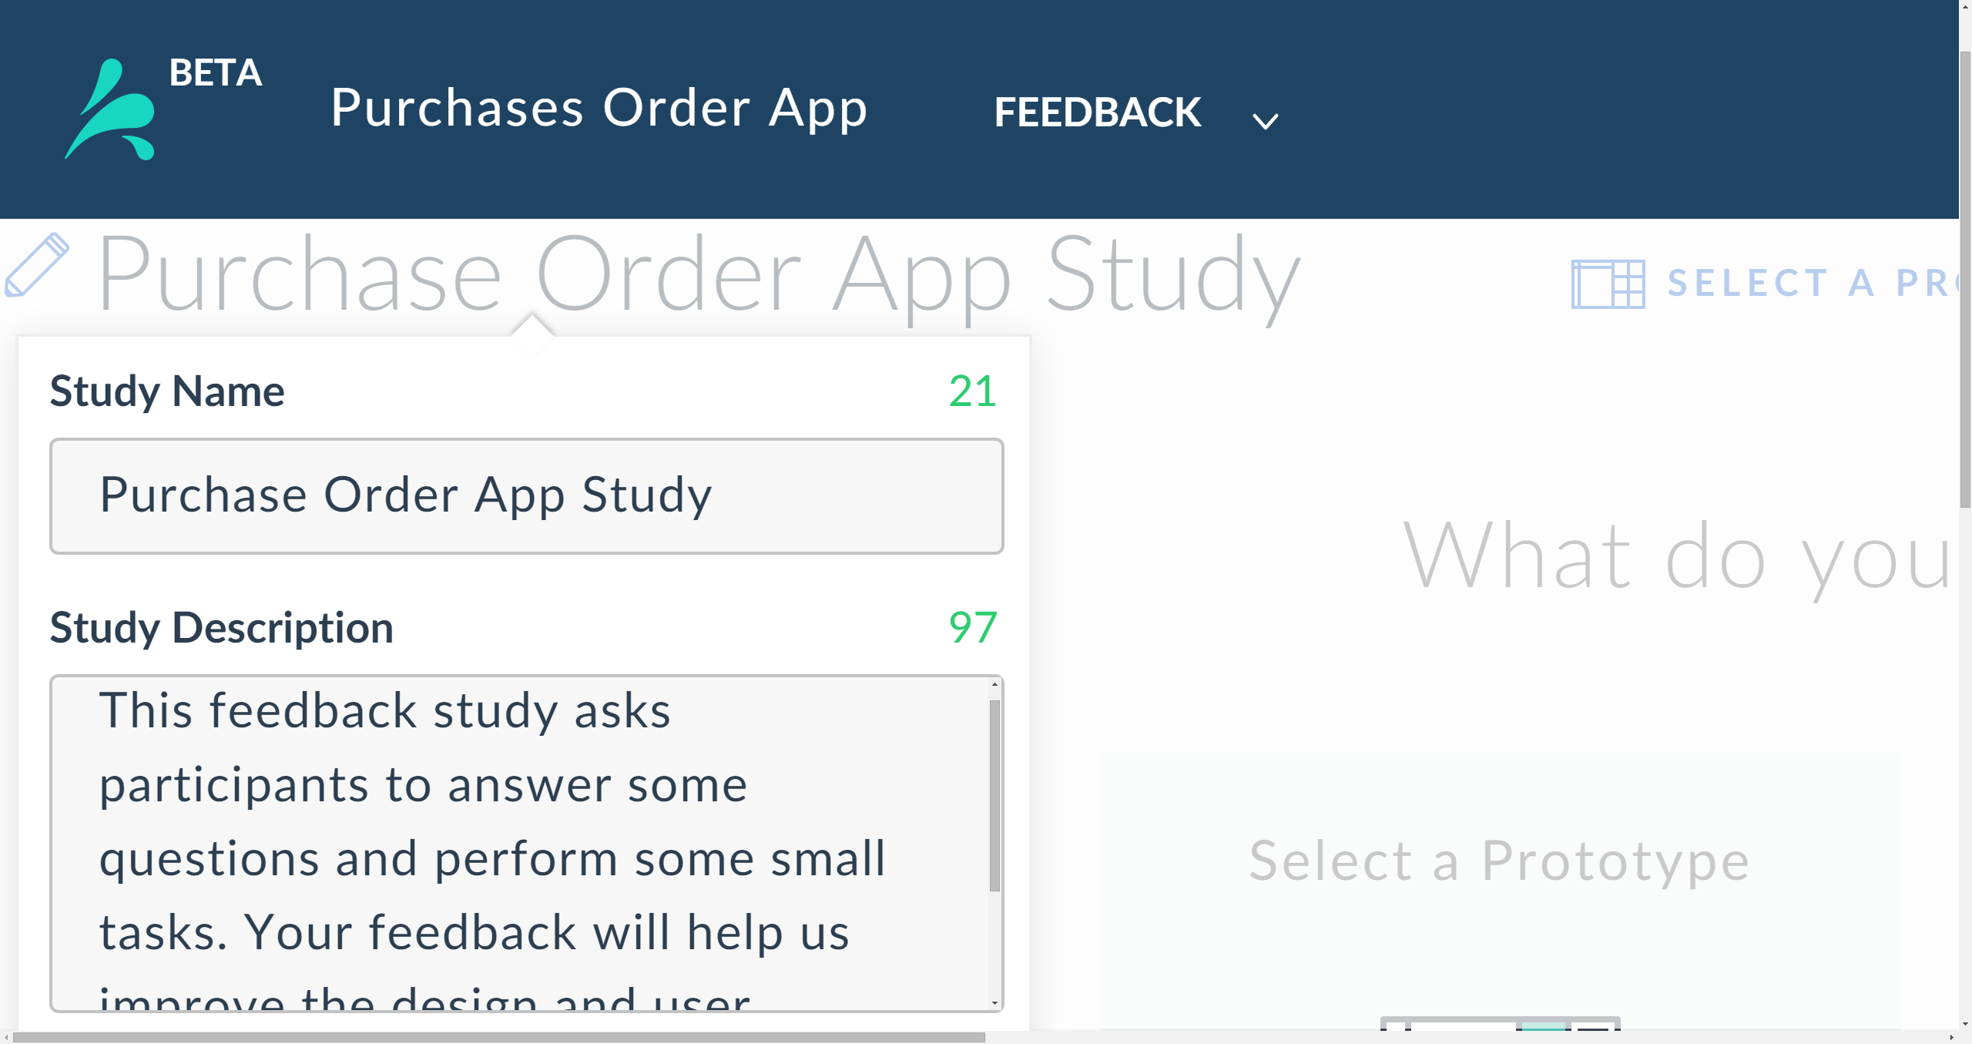
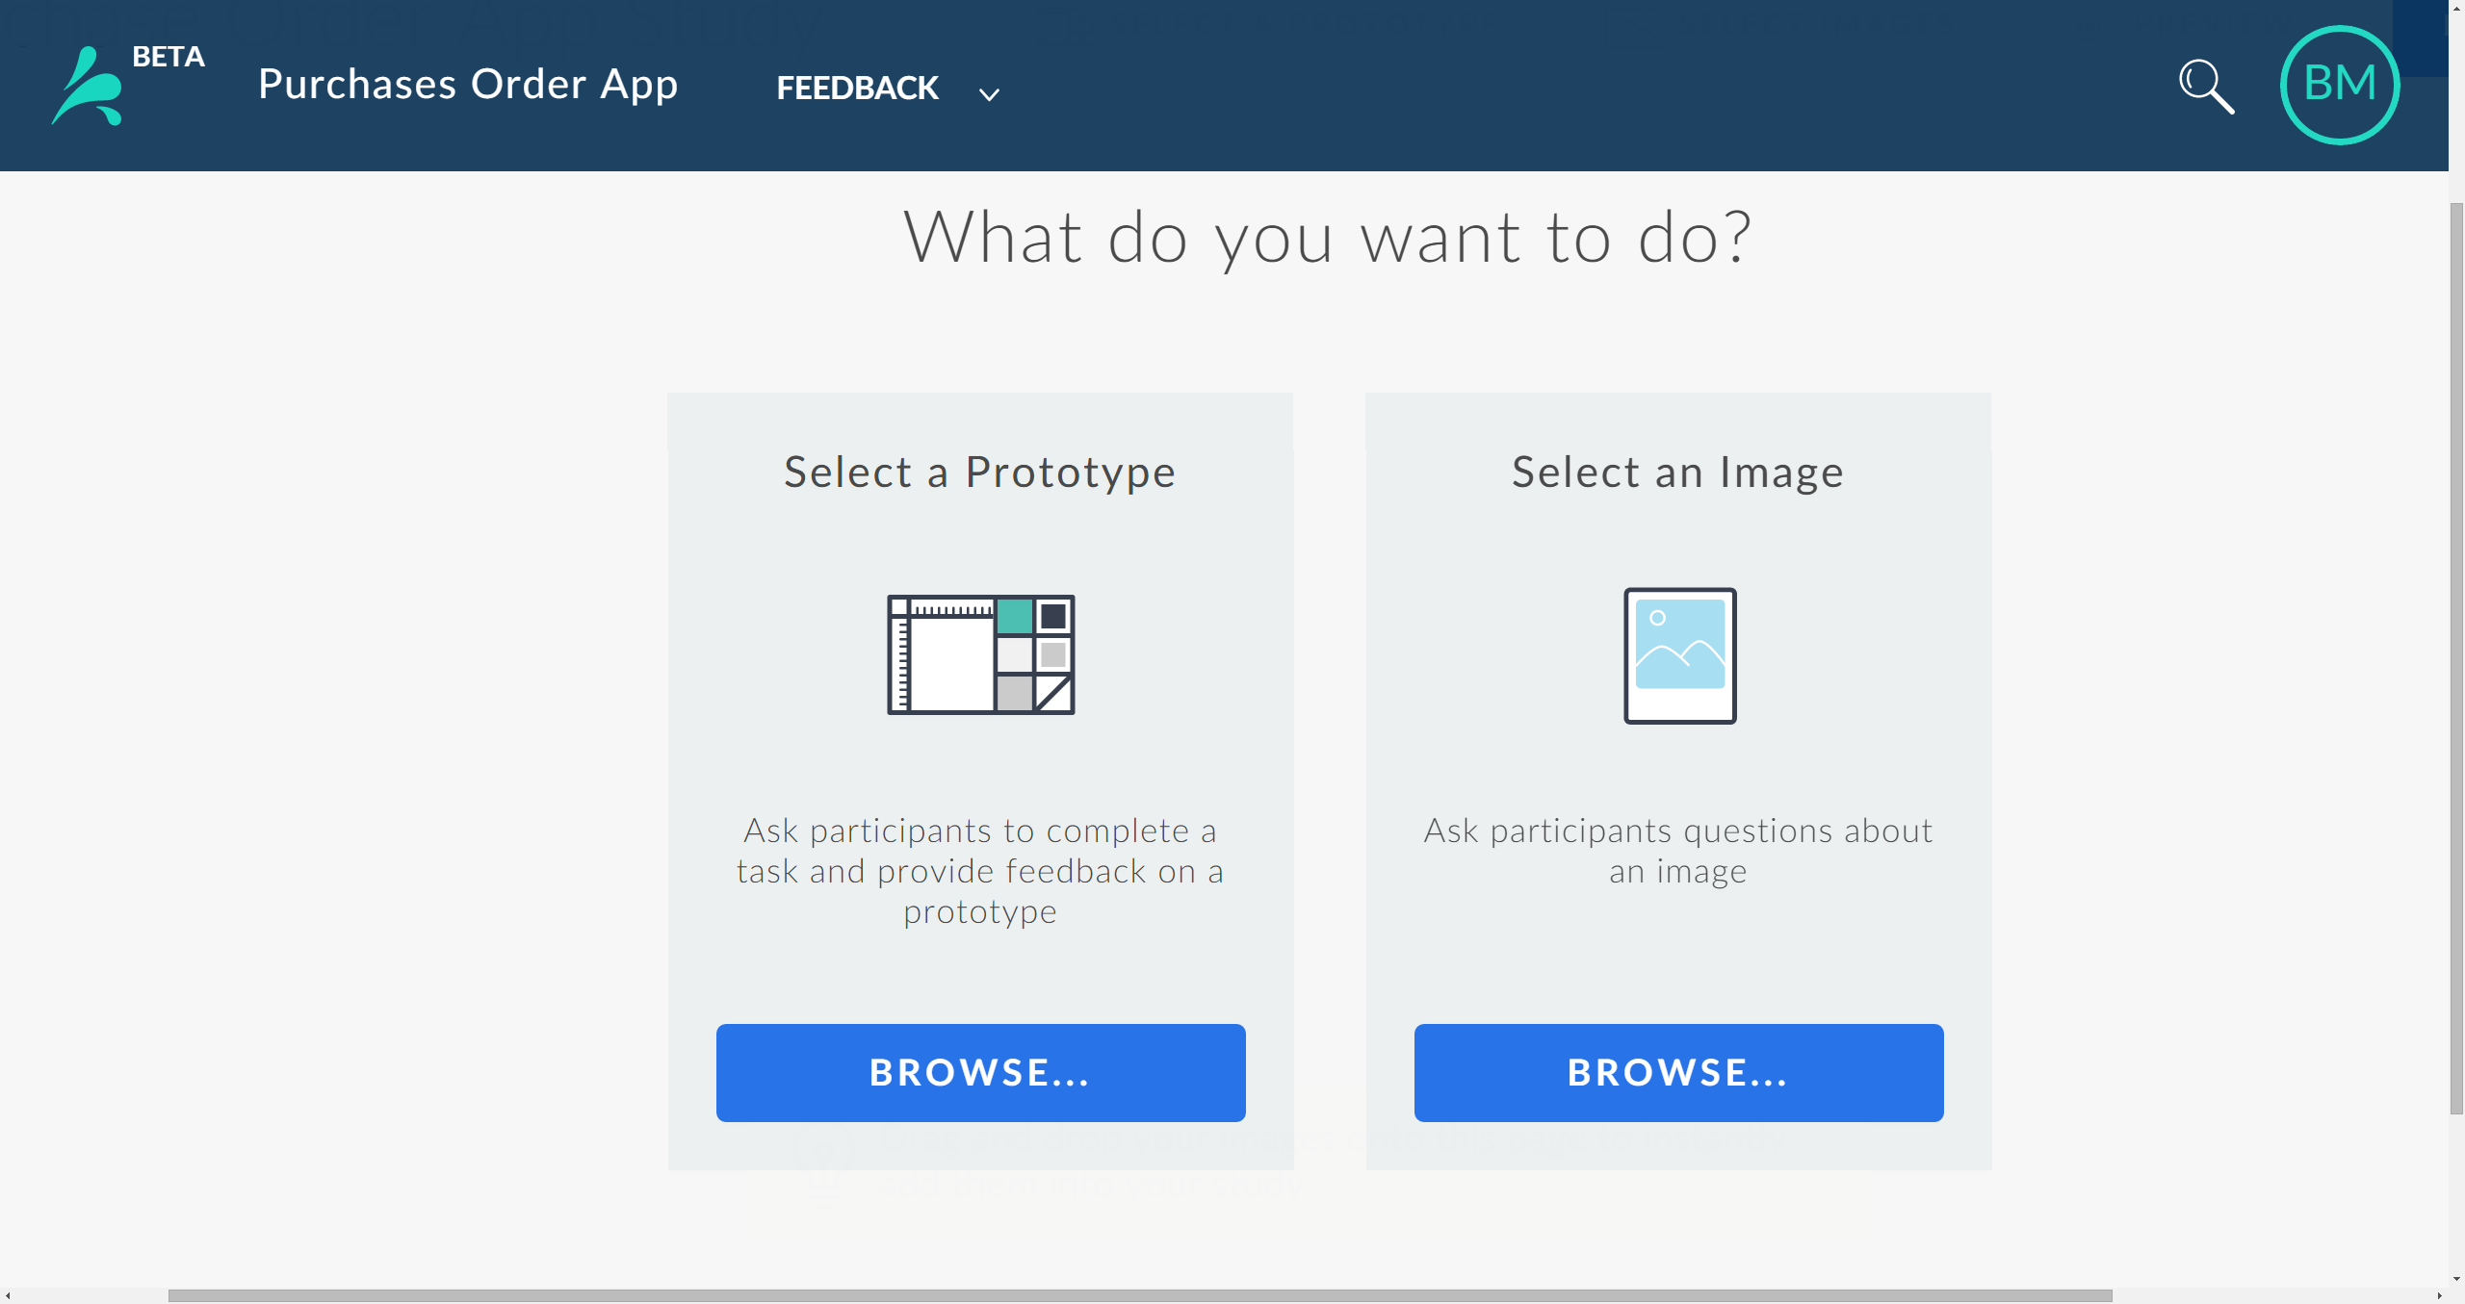
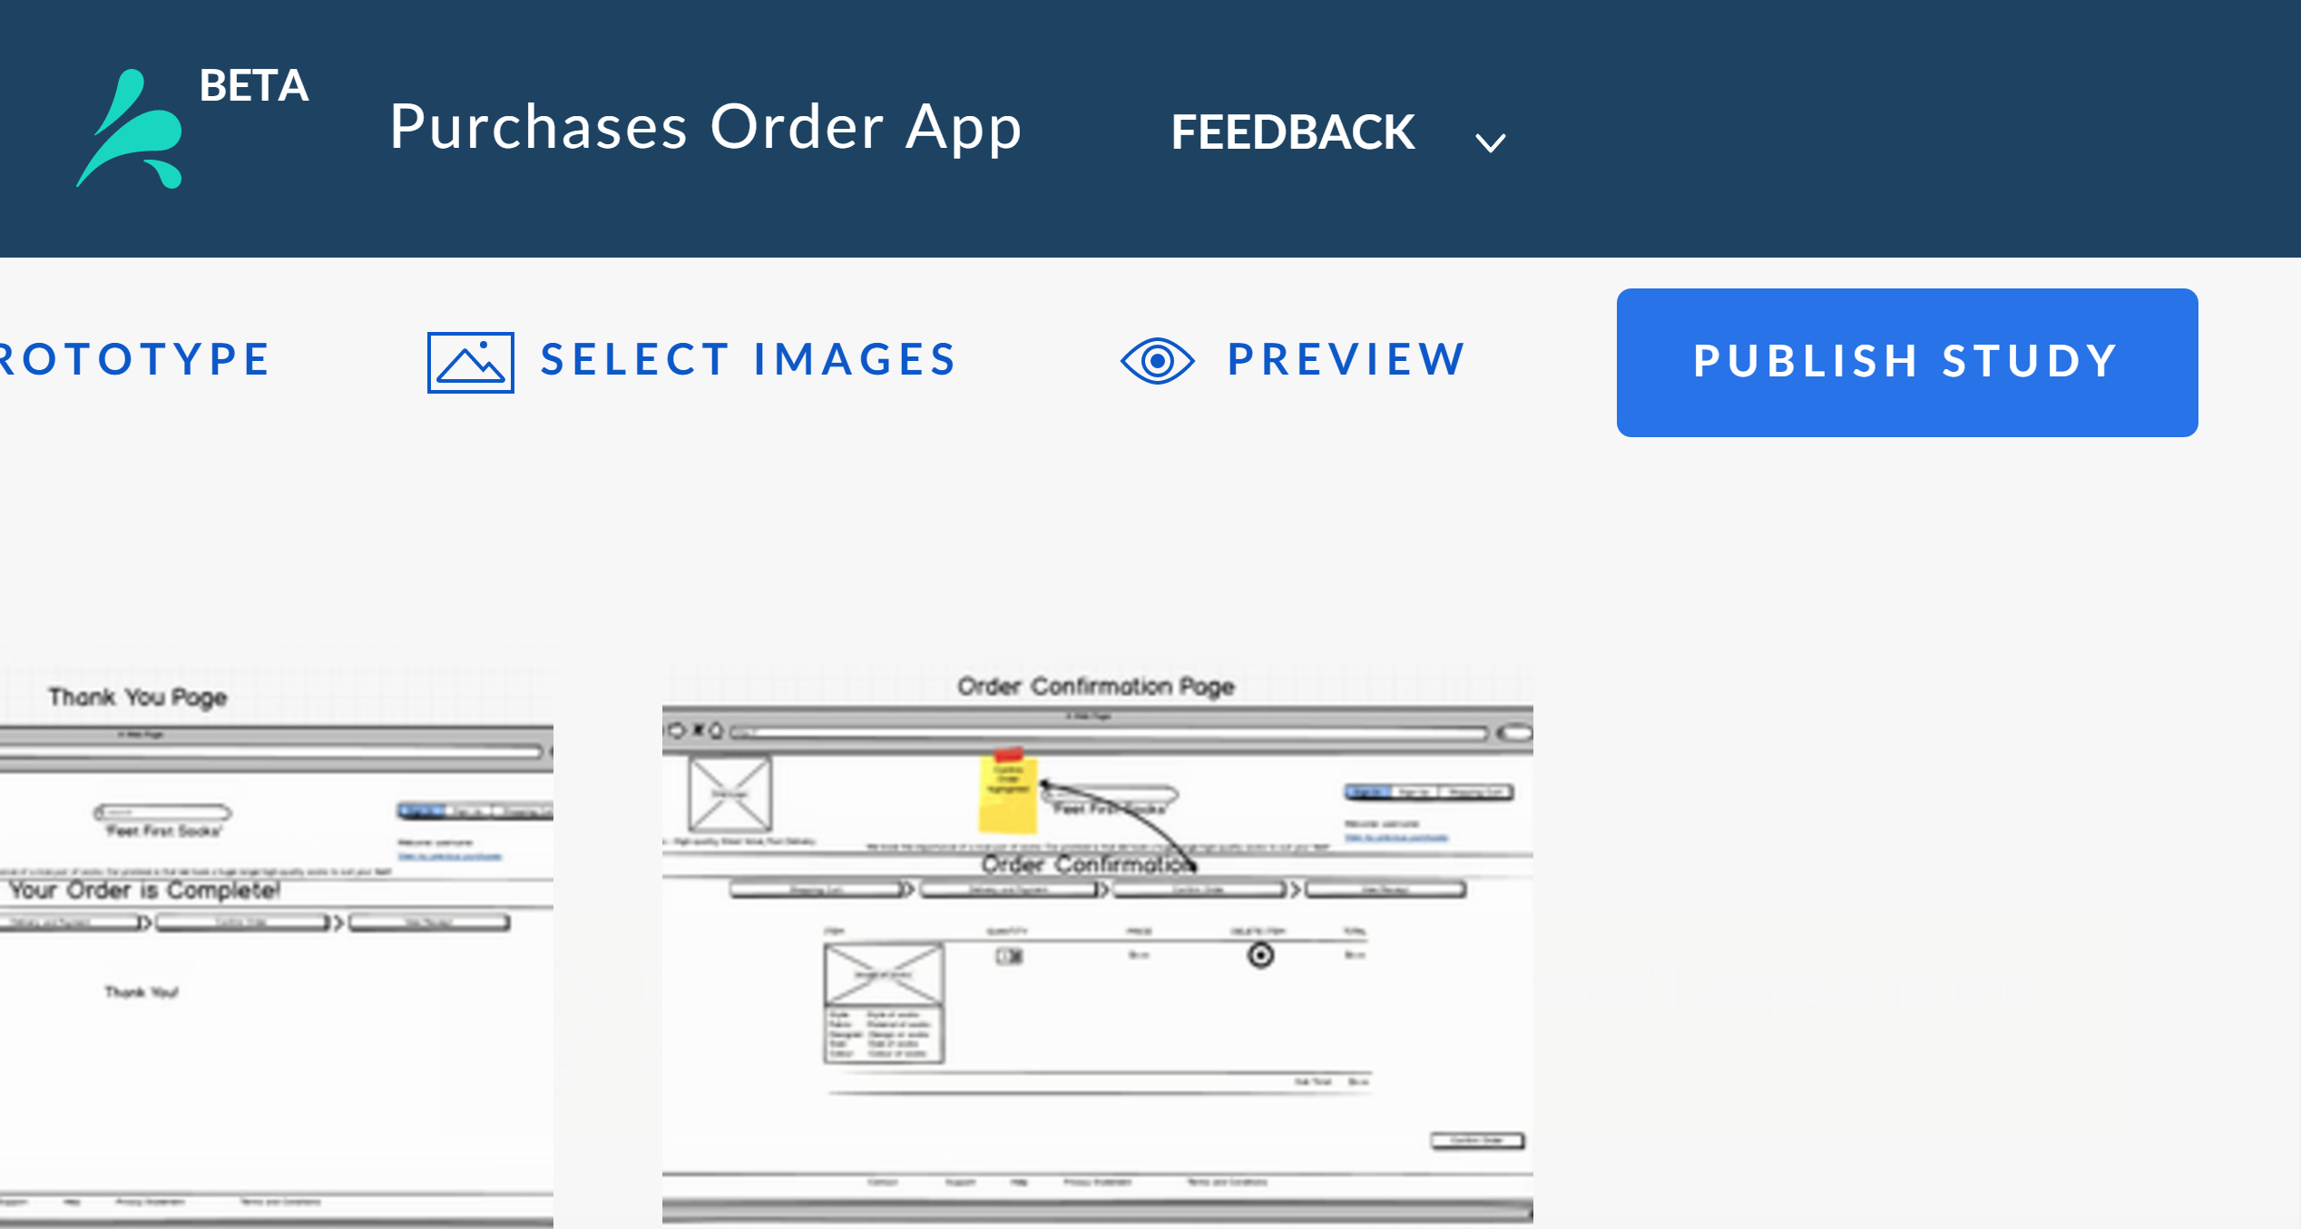
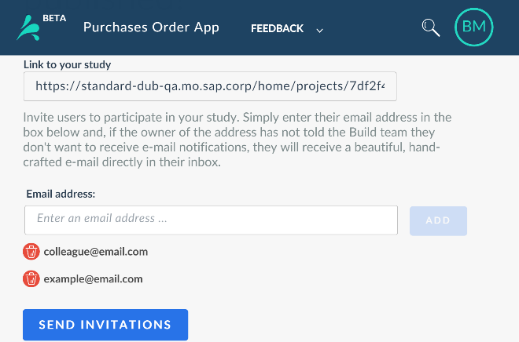
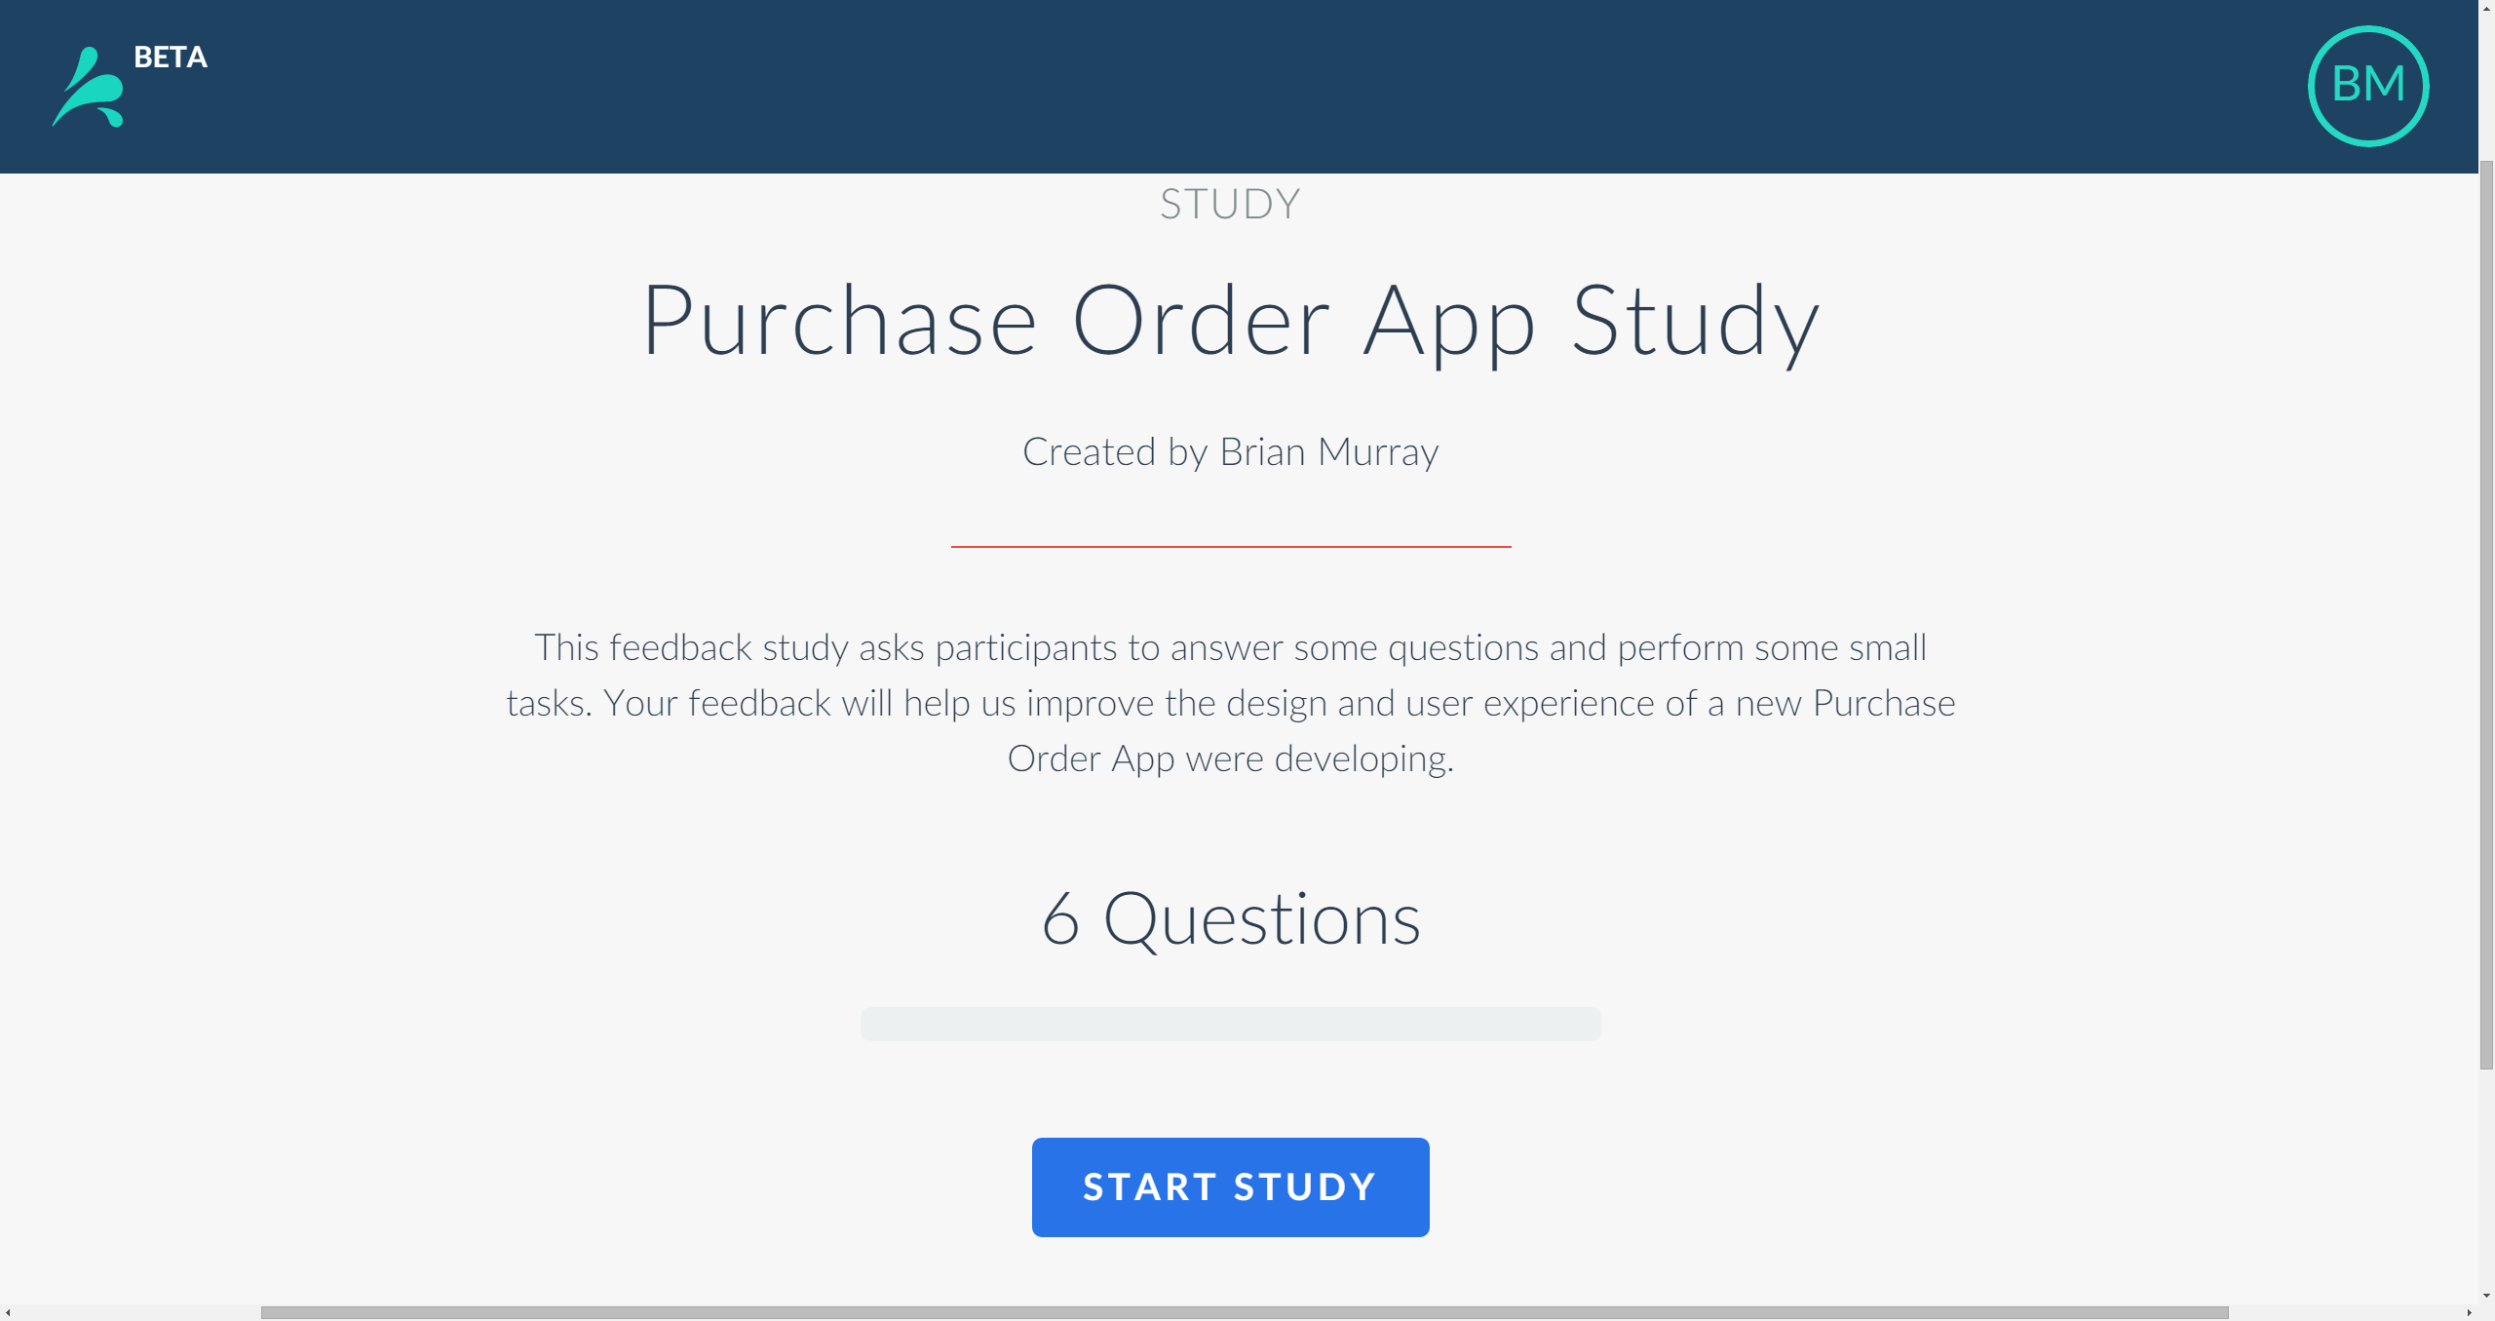
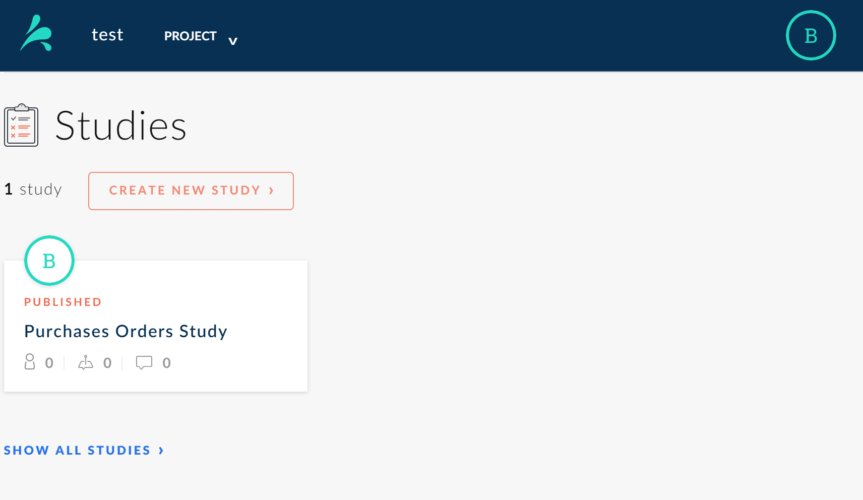
SPLASH
SPLASH Tools
quick start guide 3/8
Feedback Tool
Typical Workflow
Create a Project
Select Create a Project on the Home page.
Create a Feedback Study
Select the Tool Picker on the Splash header, select Feedback, then select New Study.
Name and Describe Study
Select Create Study on the Project page or from on the Tool Picker on the toolbar.
Add Images and Prototypes
Add images and set a question for each image. Add prototypes and set an action to be completed.
Publish the Study
Select the Publish icon on the tool bar to publish the study. A unique study-link is generated.
Share the Study
Enter the emails of people and Splash sends them an invitational email.
Participants Response to Study
Participants select study link in email. Study is displayed in their browser, and they respond to questions and tasks.
View Responses
You can your team can view the feedback almost immediately by selecting the study on the Projects page.

Slide 5
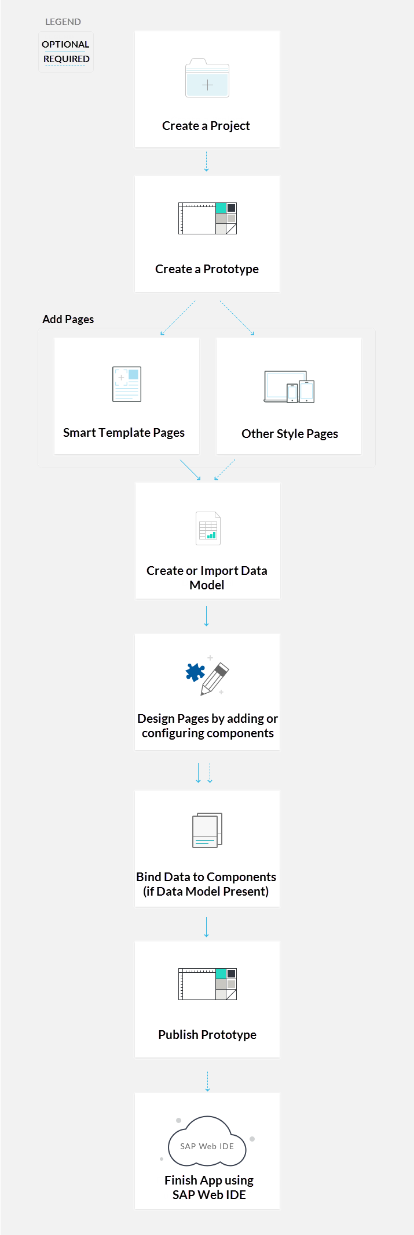
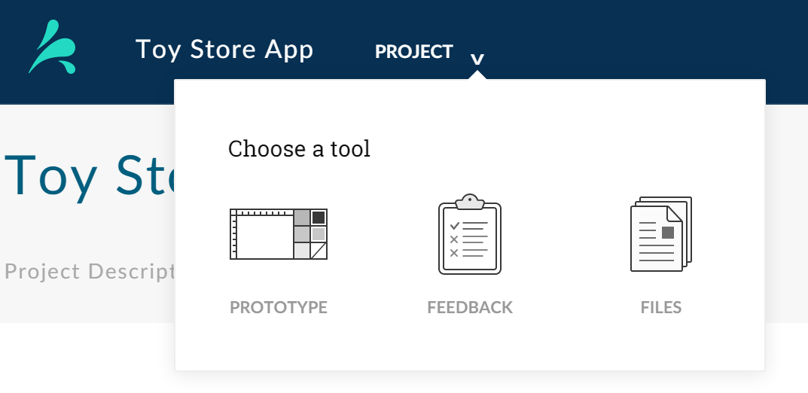
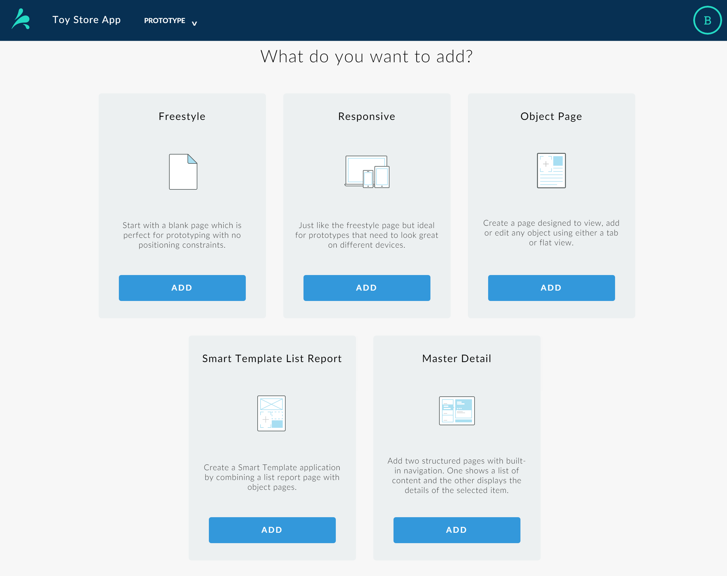
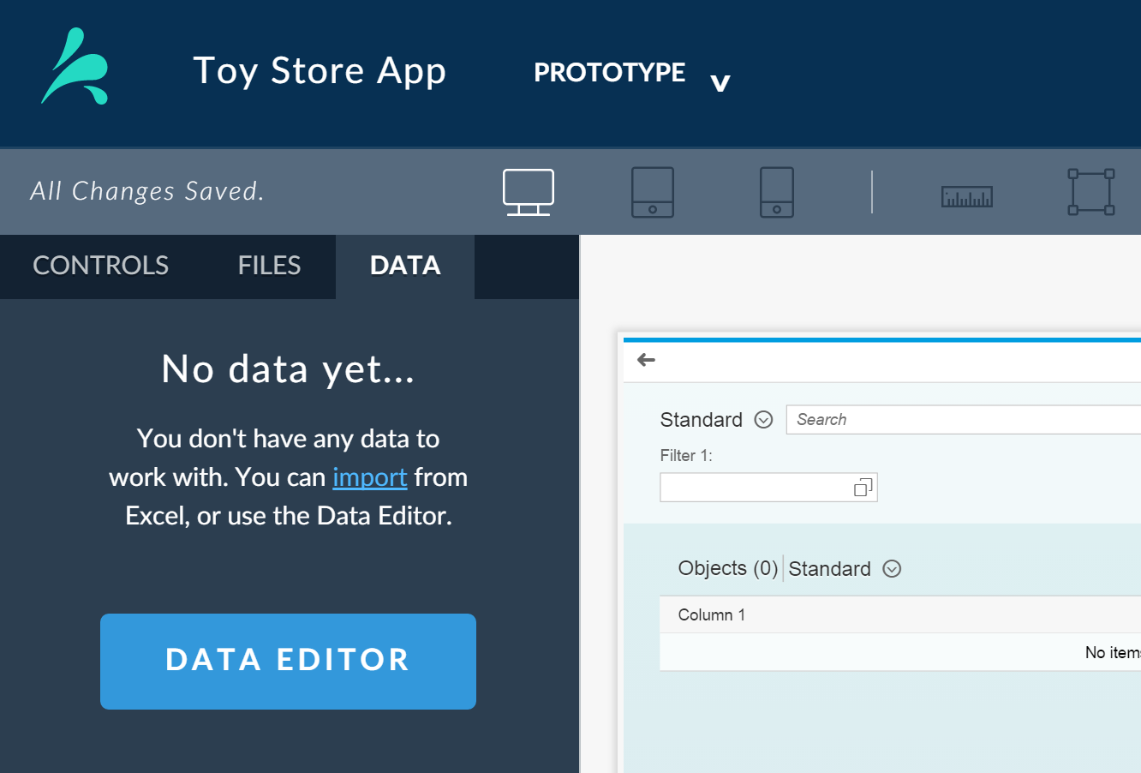
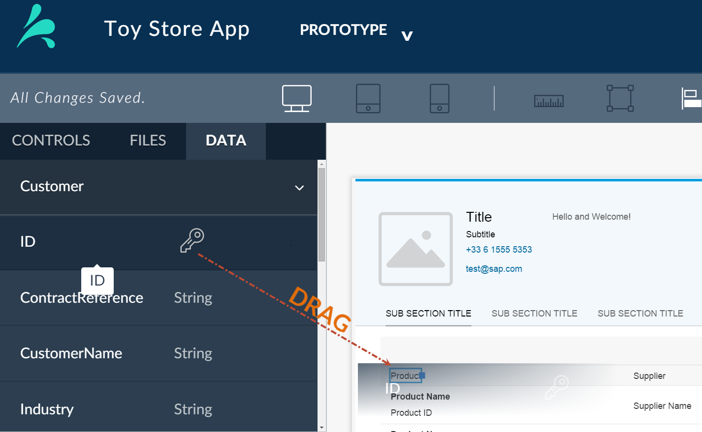
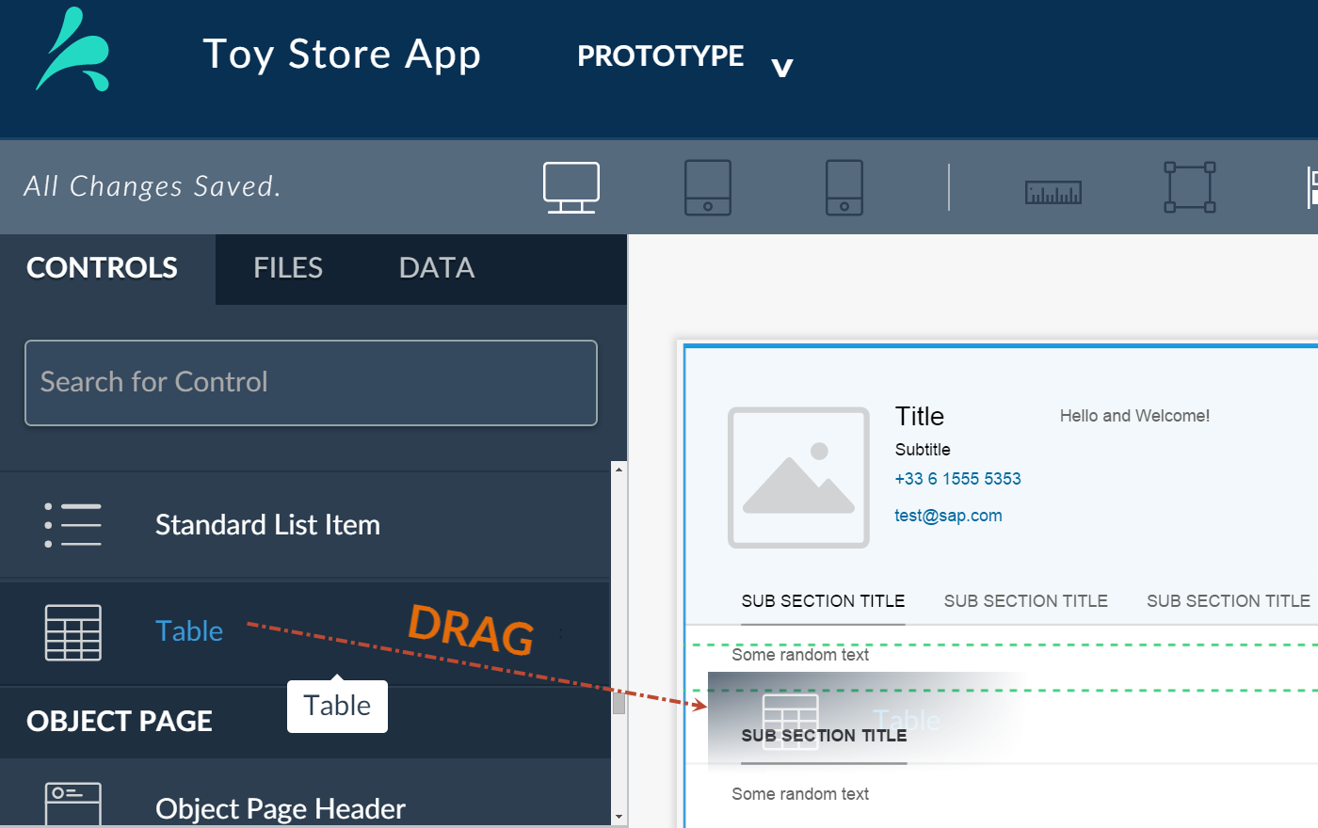
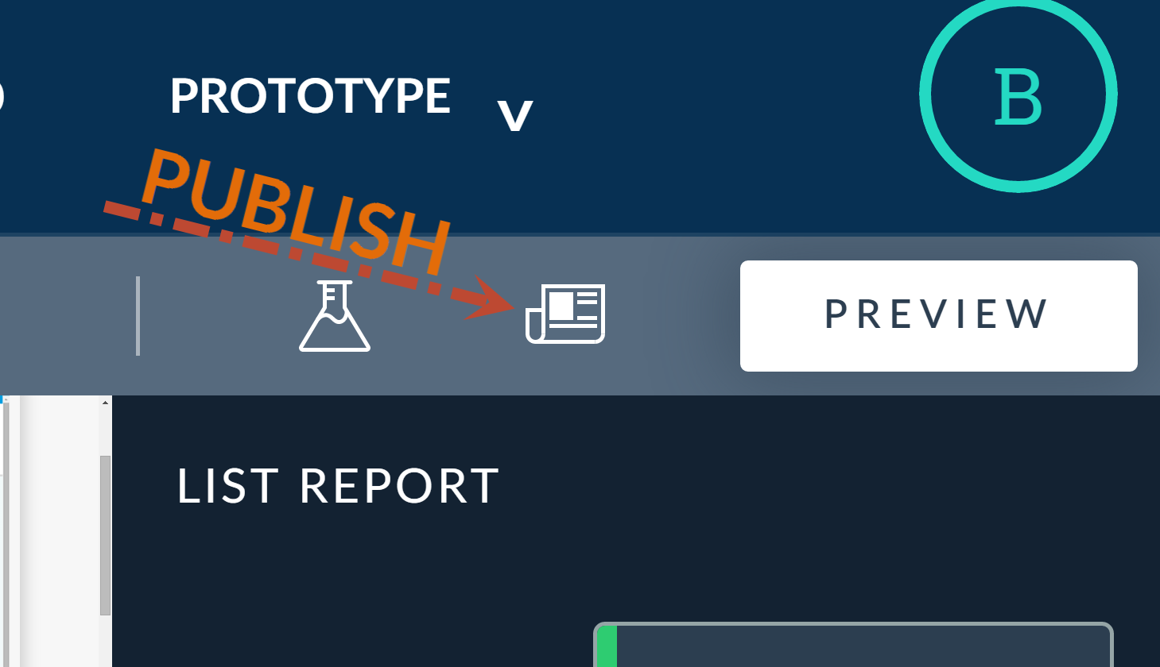
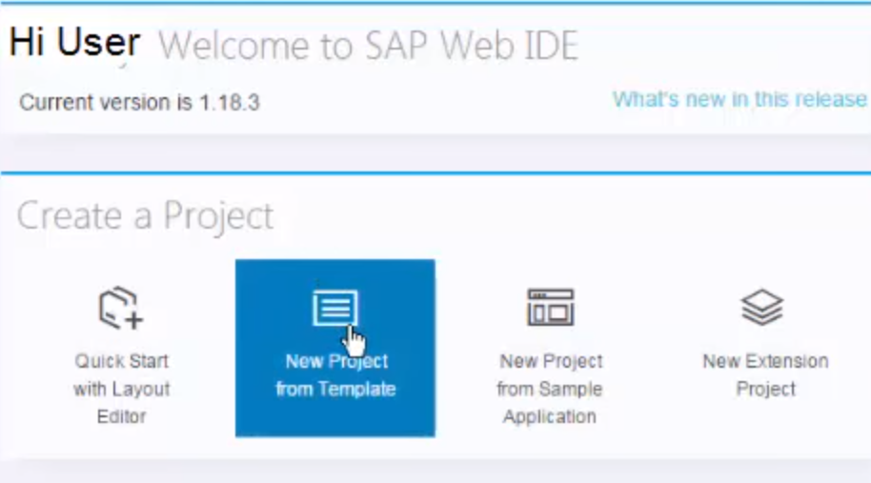
SPLASH
SPLASH Tools
quick start guide 4/8
Prototype Tool
Typical Workflow
Create A Prototype
Select Create a Prototype on the Project page or from Tool Picker.
Create a Project
Select Create a Project on the Home page.
Create Data Model
If you want to add realistic data (required for Smart Templates), select DATA EDITOR on the DATA tab.
Add Pages
Select a type of page to start with.
Bind Data
If you added a data model, select the main data object in the page Properties, and
drag the appropriate properties to appropriate controls.
Design Pages
Drag controls onto UI Compose canvas and configure them.
Finish App
Import your prototype into SAP Web IDE and finish development to create a fully functioning application.
Publish Prototype
Publish your prototype to create a unique link to you prototype app.

Slide 6
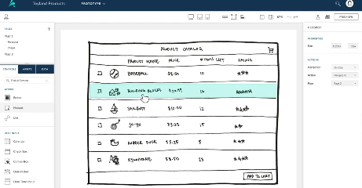
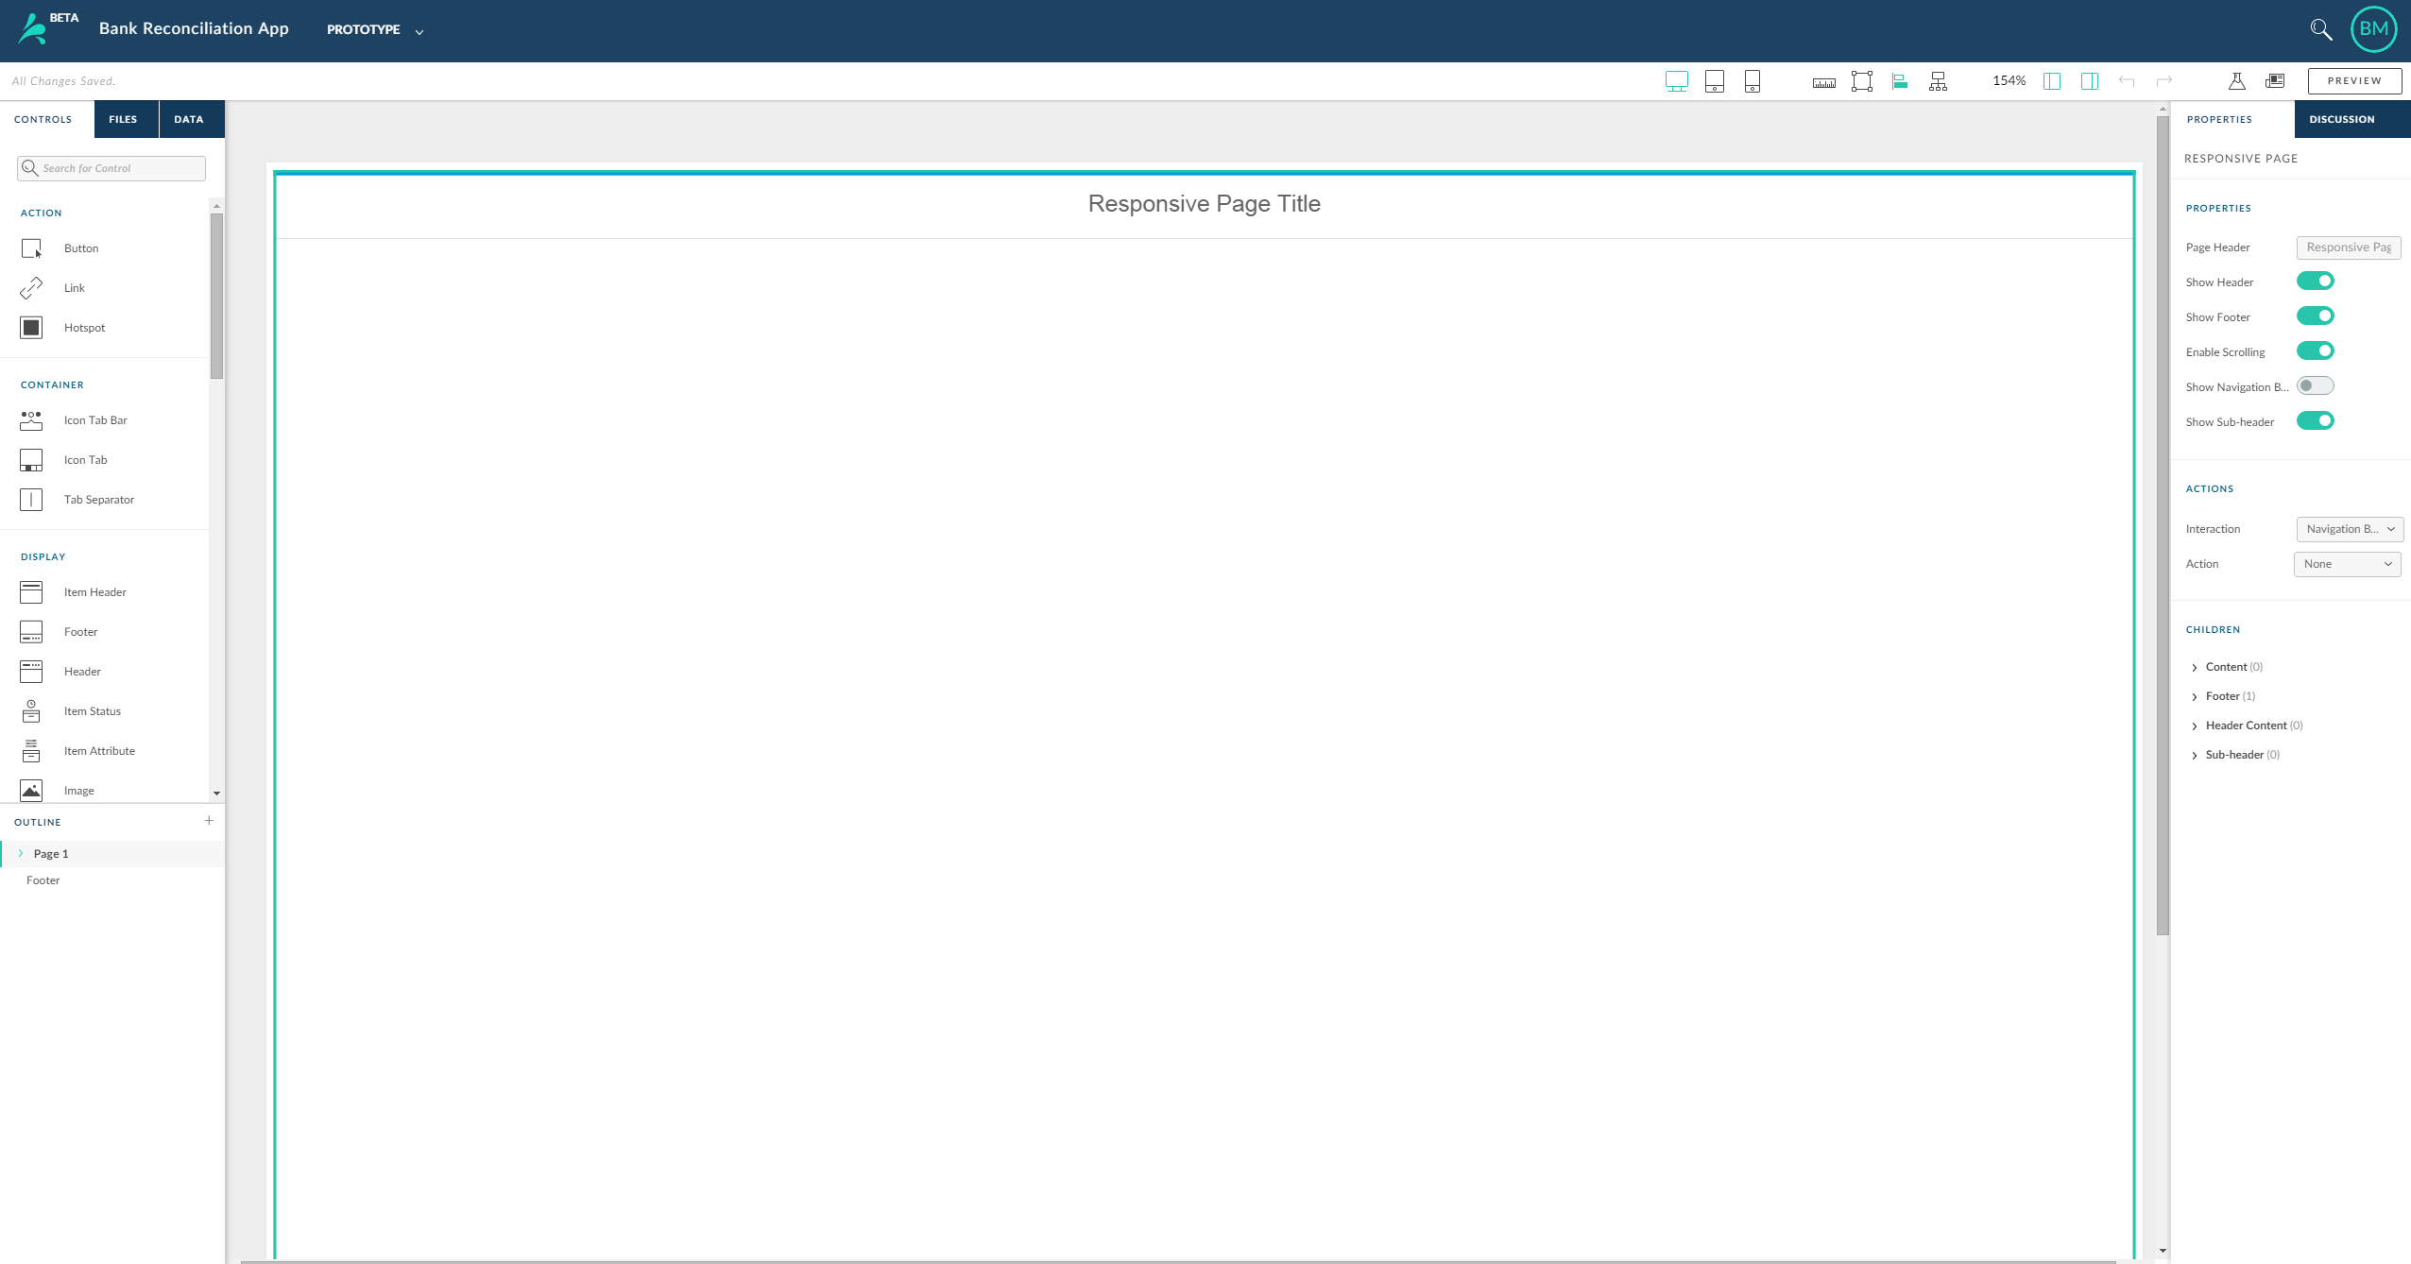
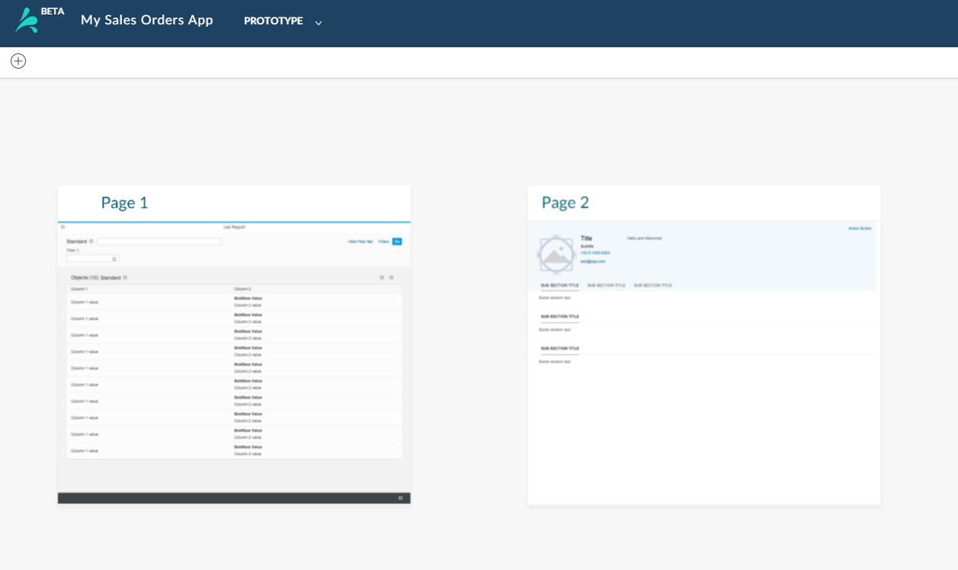
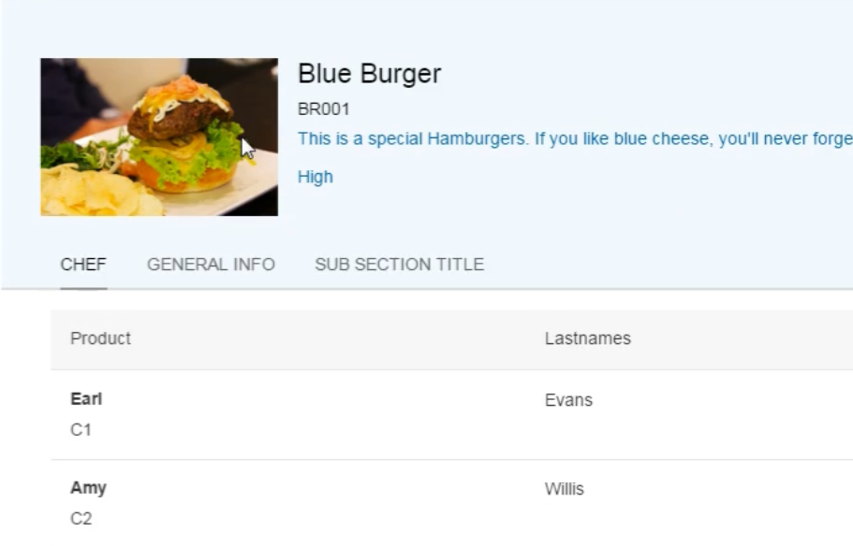

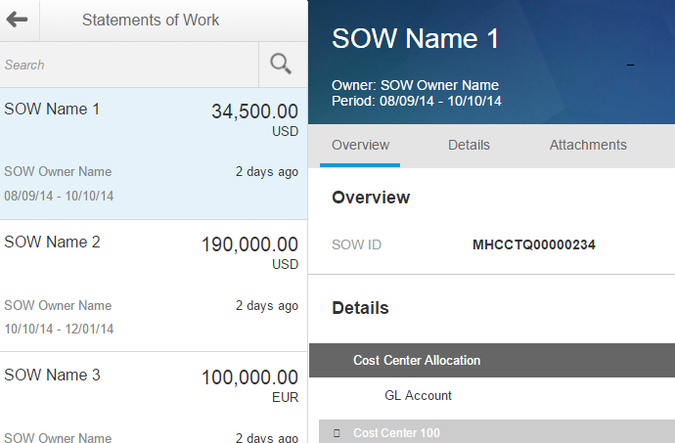
SPLASH
SPLASH Tools
quick start guide 4/8
UI Composer Pages
Mix and match page types to suit your needs
LOW FIDELITY pages Upload a hand-drawn or low fidelity image of your design. In the UI Composer add hotspots to mimic basic functions like navigating between pages, and showing alerts, dialogs, and popovers. Automatically responsive.
FREESTYLE pages Start with a blank page which is perfect for prototyping with no positioning constraints. Automatically responsive.
SMART TEMPLATE LIST REPORT /OBJECT pages Create a Smart Template application by combining a list report page with object pages. The result is an efficient way to drill-down in more details about specific topics.
RESPONSIVE pages Just like the freestyle page but ideal for prototypes that need to look great on different devices. Responsive prototype pages are responsive to the display device size.
MASTER DETAIL pages Add two structured pages with built-in navigation. One shows a list of content and the other displays the details of the selected item. Master detail prototype pages are responsive the display device size.

Slide 7







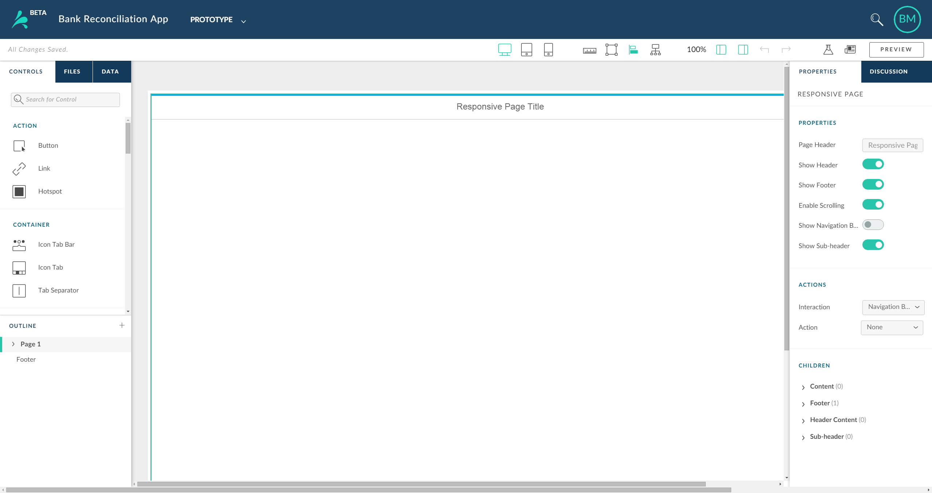




SPLASH
UI Composer – UI Editor
quick start guide
quick start guide 5/8
UI Editor
Get to know the Tools and Components you use to create your UI Interfaces
Controls Tab
Data Tab
Tool Picker
Display Format
Page View
Zoom Tool
Feedback
Publish
The UI Editor includes built-in Open UI5 UI controls that you can use to make prototypes interactive, without writing a single line of code.
To add a control, simply drag it onto the canvas.
Access the Data Editor to create and bind sample data for a more realistic prototype.
Use the Tool Picker to switch between the Prototype, Research, and Files tools.
Change the display format between desktop, pad, and phone.
Display the page view of your prototype, where you can set the page flow and add new pages.
Magnify and reduce the
Canvas.
Create a feedback study based on your prototype, and sent the study to end users to get feedback.
Publish your prototype to generate a link to the prototype that you can share with others.
Files Tab
Properties
View a list of project images you drag onto the canvas in the UI Editor or project files you upload from the Files Tool.
Customize the look and feel of your prototype, including button labels, color, and so on.
Canvas
This is your workspace for creating prototypes.
Actions
Use the Tool Picker to switch between the Prototype, Research, and Files tools.
Outline
Use the Tool Picker to switch between the Prototype, Research, and Files tools.

Slide 8
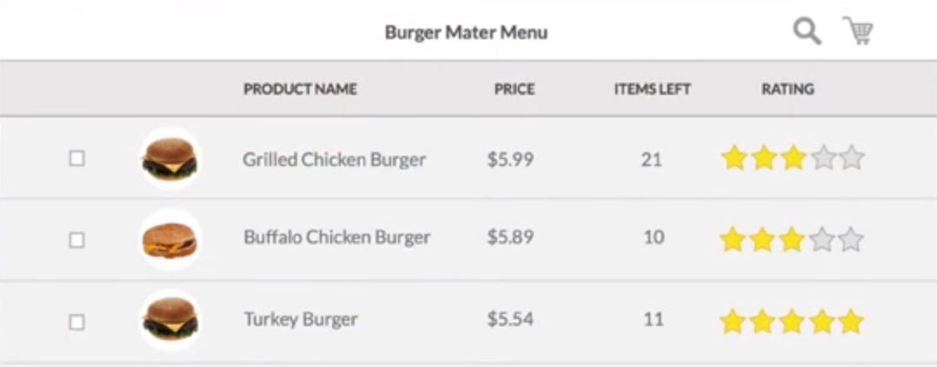
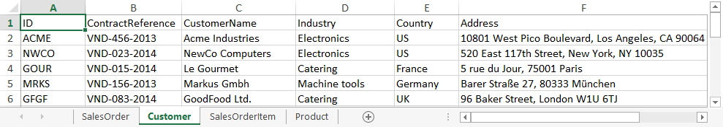
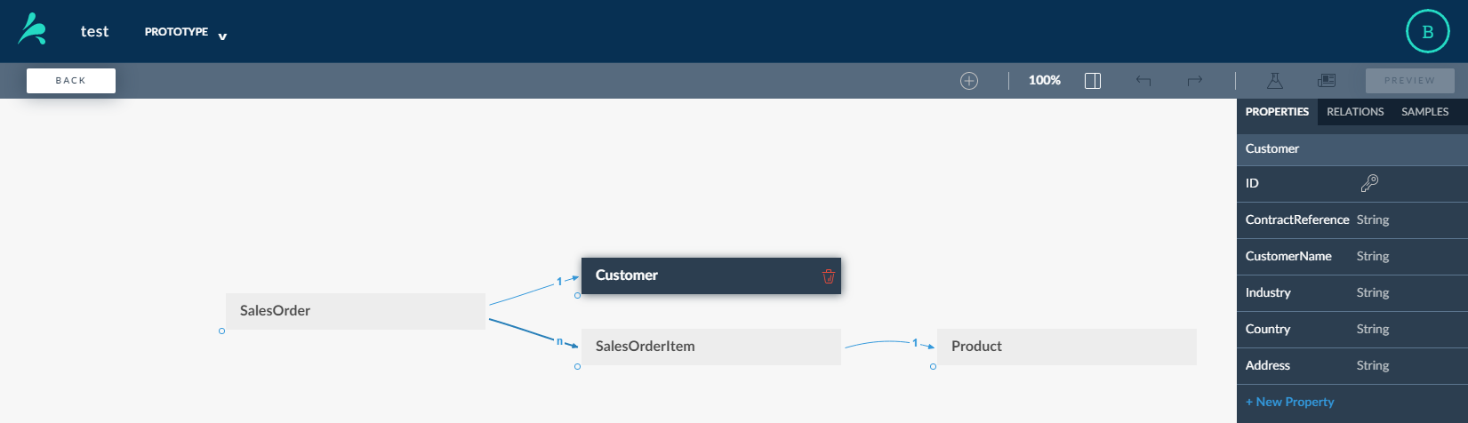
SPLASH
Data Models in Splash
quick start guide 7/8
Learn about Data Models in Splash
Data Models
Splash enables you to add realistic data to your prototype. You an add your own data, or use sample data provided in Splash. The data isn’t just for show. It can really make the workflows in your prototype easier for your potential end-users to understand show.
Important: Adding data is Splash is requires a basic understanding of relation databases. However, the graphic below introduces the basic concepts.
Learn about the Controls on the Data Editor
UI Composer – Data Editor
Back
Add Data Model
Data Object Properties
Data Object Relations
Return to UI Design Editor.
Data Model in Excel
Relations between Data Objects can be one-to-one, one-to-n (or many), or there may be no relation. The default is one-to-many.
Create, search for, or import a Data Model.
A property is a category of data. Similar to columns in database tables.
Data Object Samples
A sample contains a set of values corresponding to each property in the Data Object. Similar to rows in database tables.
Data Model
The data objects of your data model are displayed here on the canvas. Similar in concept to a database.
We created this using the Excel data model above.
Properties of Select Data Object
These are the properties of the Customer data object. You can visual each as a column in a table. Each property contains a sample value. You can visualize a sample as a row in a table containing a value for each property.
Data Objects
Add New Property
Contain columns representing different Properties, and rows, each containing Sample values for each category. Similar in concept to tables in databases
Select to Add a new property to the selected Data Object.

Slide 9
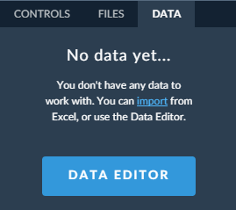
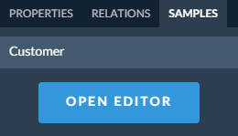
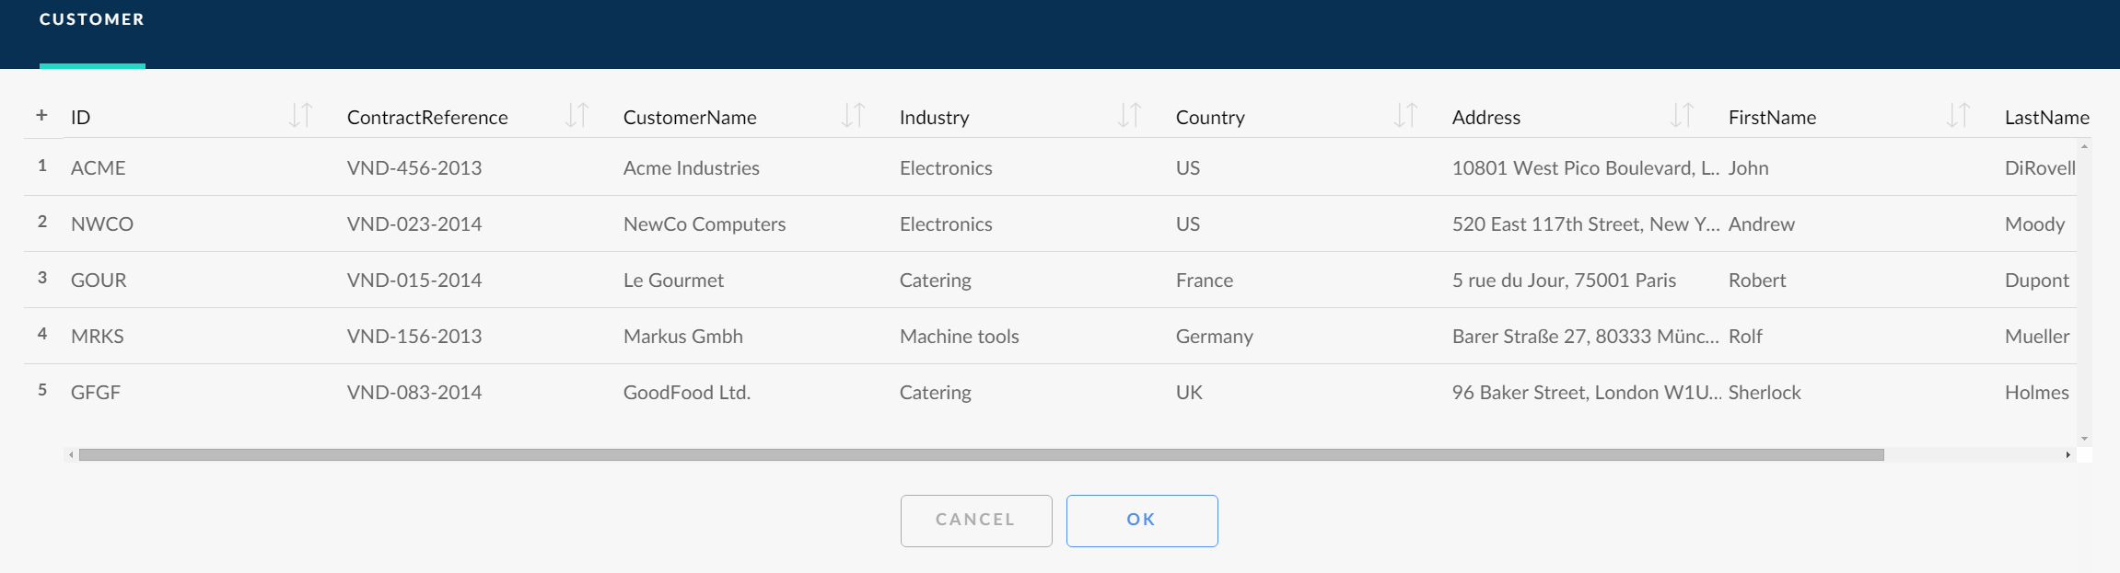
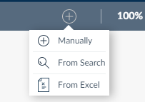
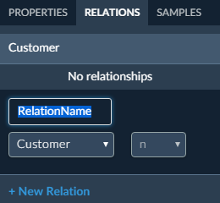
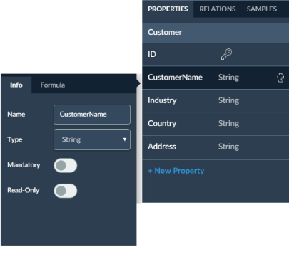
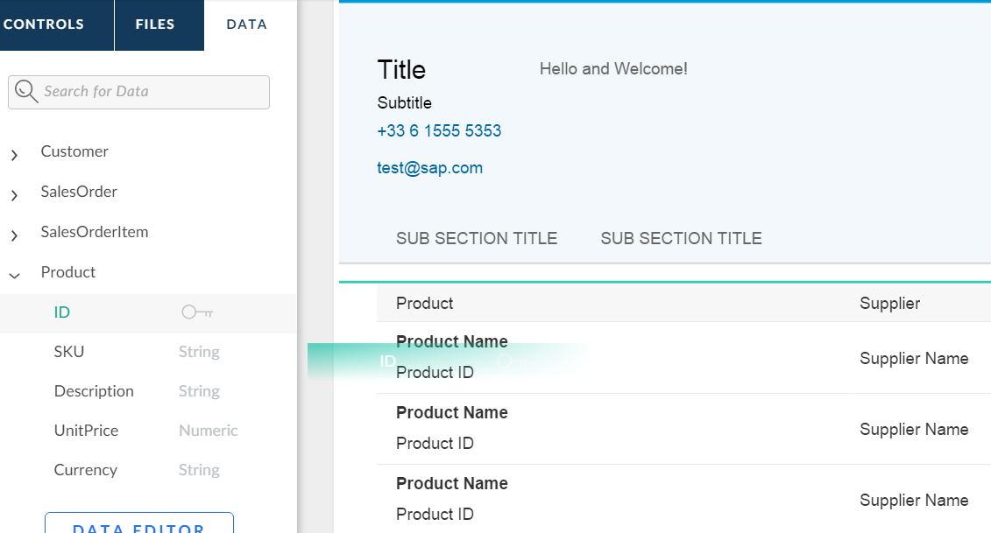
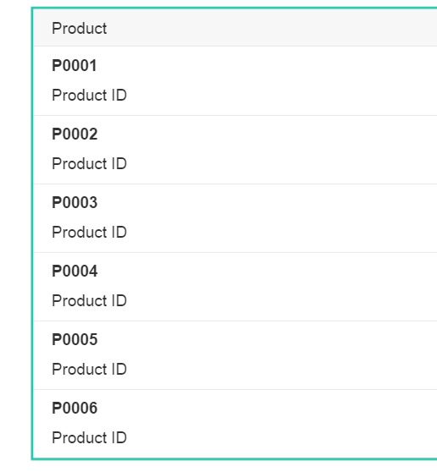
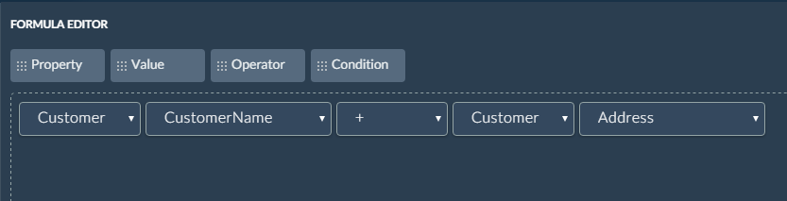
SPLASH
quick start guide 8/8
UI Composer – Data Editor
Add Data to Your Prototype
How to add Data to Your Prototype
1. Open the Data Editor
4. Define or Edit Data Object Samples
Select the Data tab on the right side of the UI Composer, and select DATA EDITOR.
To define or edit the sample values of a data object, you select the data object on the canvas, and select the SAMPLES tab.
Select OPEN EDITOR, and edit or add new sample values to the Data Object.
2. Add a Data Model
Select the + icon on the toolbar to:
Manually in the Splash Data Editor
By searching provided sample Data Models
By creating a Excel Data Model and importing it
5. Define or Edit Data Object Relations
To define or edit the sample values of a data object:
1. Select the data object on the canvas.
2. Select the SAMPLES tab.
3. Define or Edit Data Object Properties
3. Enter a unique name for the relation.
4. Select the Data Object you want to link with the selected Data Object.
5. Select the cardinality of the relationship.
Select the data object on the canvas, and select the PROPERTIES tab, and select a Property to edit:
Data object
Name of property
Datatype
Whether a sample value
Is mandatory for this property
Whether it is read-only
Primary key Property
6. Bind Data to Pages
From the Main Object drop-down on the Properties tab on the right panel, select the data object you want to use on this page.
Select a control on a prototype page that it is possible to bind data to, such as a table or a grid.
From a drop-down in the Properties panel Select the property of the Main Object that you want to apply to the UI component, and it is applied to the UI component.
Properties
Drag ID property from Data Object to a column
Create a new property by selecting +New Property. Enter a name, select the Formula tab and define a formula for the new property. For example, the following formula creates the MailAddress property:
Release and the sample values in the ID property populate the column
Important: You must have a Data Model for Smart Templates pages, and must select the same Main Object for the List Report and Object pages.

